Slide 1
Equity, Diversity and Inclusion Portfolio objective and plan
Cedric Simenel and Phillip Urquijo

Slide 2
Vision
Leading by example towards equity and diversity through inclusion, flexibility, and inspiring new generations

Slide 3
Missions
Improve gender balance in STEMs through ambitious policies
Support families and carers
Inspire a new, more diverse generation toward STEMs
Build a culture of respect and inclusion

Slide 4
Themes
Towards gender balance at all levels
Flexible working conditions and environment
Social, gender and ethnic diverse STEM students
Respectful and inclusive community

Slide 5
Theme 1: Towards gender balance at all levels
Hiring policies
Support events with best practice
Monitor evolution of gender balance
Engage with external programs (MAGIC, Women in STEMs…)
Key role to female members
Work with Mentoring portfolio

Slide 6
Theme 2: Flexible working conditions and environment
Part time positions
Family friendly meeting times and event schedule
Carer support
Working arrangements

Slide 7
Theme 3: Social, gender and ethnic diverse STEM students
Research internships
Role models
Mentoring program to students with diverse background
Contribute to outreach program of Engagement portfolio

Slide 8
Theme 4: Respectful and inclusive community
Codes of conduct
Child care support at Centre events
Inclusive social events
Awareness to EDI issues
Report and act upon potential code of conduct breaches

Slide 9
Strategy Plan
Vision
4 missions
4 themes
19 Objectives
53 projects
33 KPIs
Proposed budget:
1885 CDM hours paid (over 7y)
1070 hours inkind (over 7y)
CDM cash 11k/a [carer support 3k, research internship 5k, child care 3k]

Slide 10
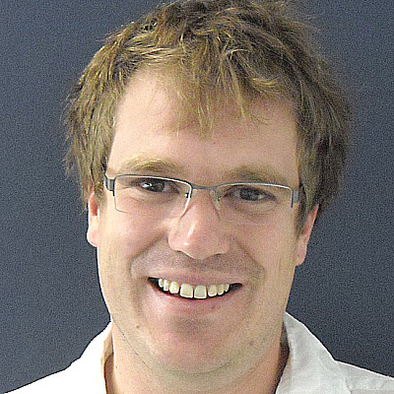
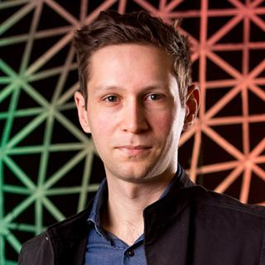
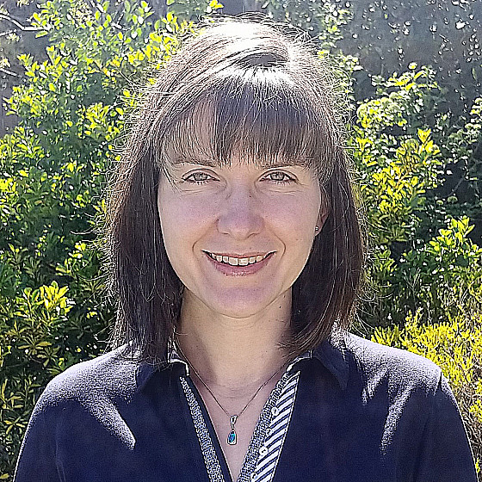
Committee
Cedric Simenel (ANU) – co-chair
Phillip Urquijo (UoM) – co-chair
Michaela Froehlich (ANU)
…
Everyone welcome!

Slide 11
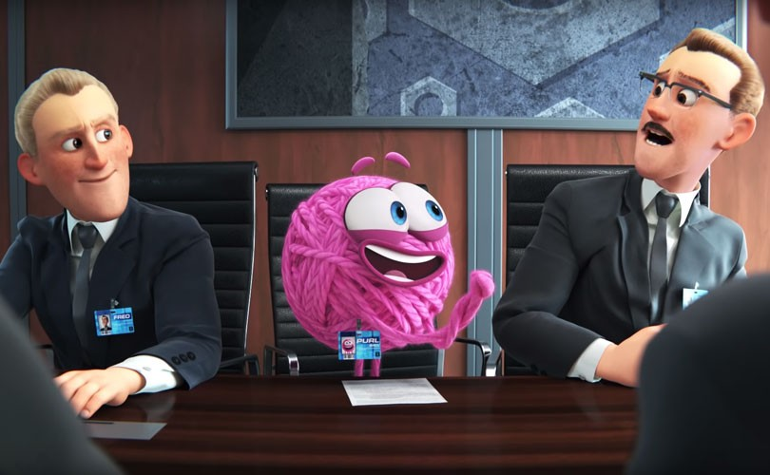
Theme 4: Respectful and inclusive community
Code of conduct
Child care support at Centre events
Inclusive social events
Awareness to EDI issues
Report and act upon potential code of conduct breaches
https://www.youtube.com/watch?v=B6uuIHpFkuo

