Slide 1
Effect of nuclear structure in WIMP-Nucleus elastic scattering
Cedric Simenel, Navneet Krishnan
ANU Research School of Physics

Slide 2
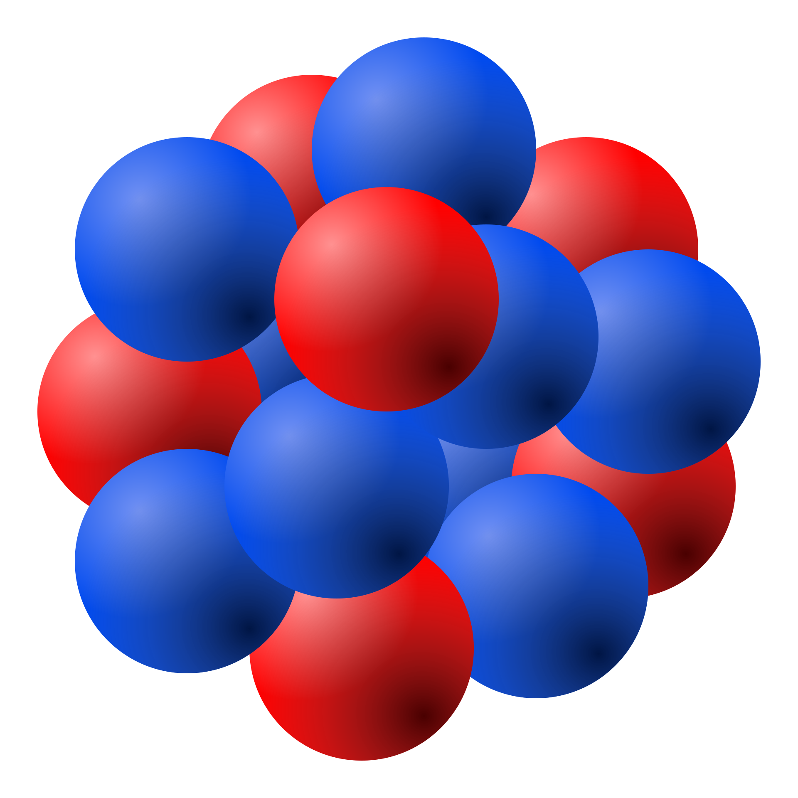
WIMP Direct Detection
Elastic scattering of a WIMP with a target nucleus
Particle physics
Nuclear physics
Nuclear recoil
S_{N}
Naive picture: point like nucleus
-> SI and SD interactions: W_{n} from
-> v ∼ WIMP velocity (∼10⁻³c)
E_{R}=q²/2M_{T}
S_{X}
q
v
Realistic picture: finite size nucleus
->
-> v ∼ nucleon velocity (∼10⁻¹c)
WIMP
Fitzpatrick et al, JCAP 004, 1302 (2013)

Slide 3
Nuclear structure
Shell model
Mean-field model
…
Unoccupied
X
X
X
X
X
X
X
X
X
X
Valence
X
X
X
Core
…

Slide 4
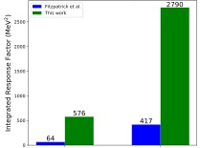
Nuclear response functions
Integrated response (0-100MeV): spin-orbit term
¹⁹F
Mean-field
Shell model
Protons
Neutrons

Slide 5
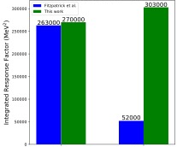
Nuclear response functions
Integrated response (0-100MeV): spin-orbit term
¹²⁷I
XXXXXXXX
x
x
Shell model
X
X
X
X
X
Mean-field
Protons
Neutrons
Protons
Neutrons

Slide 6
Perspectives
Beyond mean-field techniques

