Slide 1
Modelling Current biased Josephson junction single photon counters
Graeme Flower, Michael Tobar, Maxim Goryachev, Ben McAllister
Theory in collaboration with Thomas Stace (UQ)

Slide 2
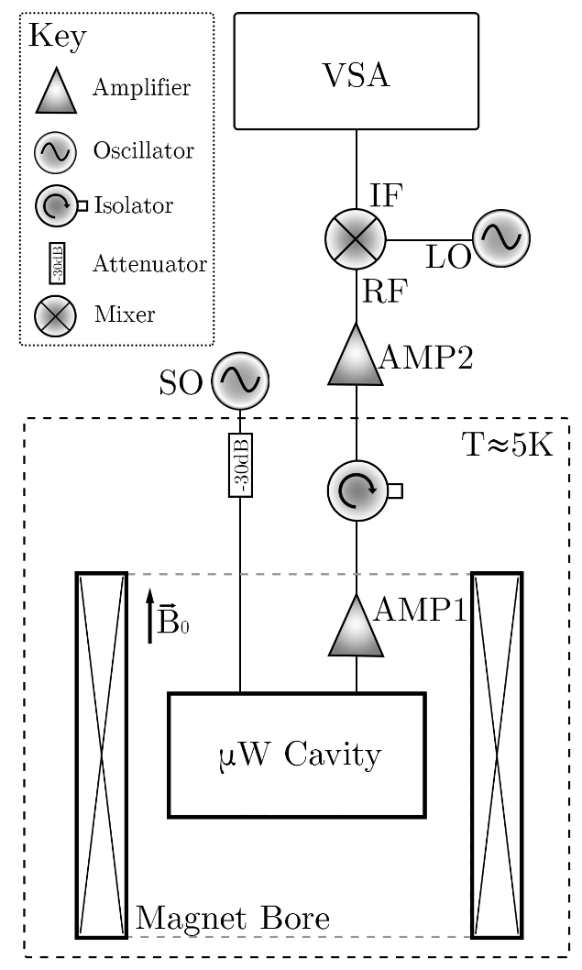
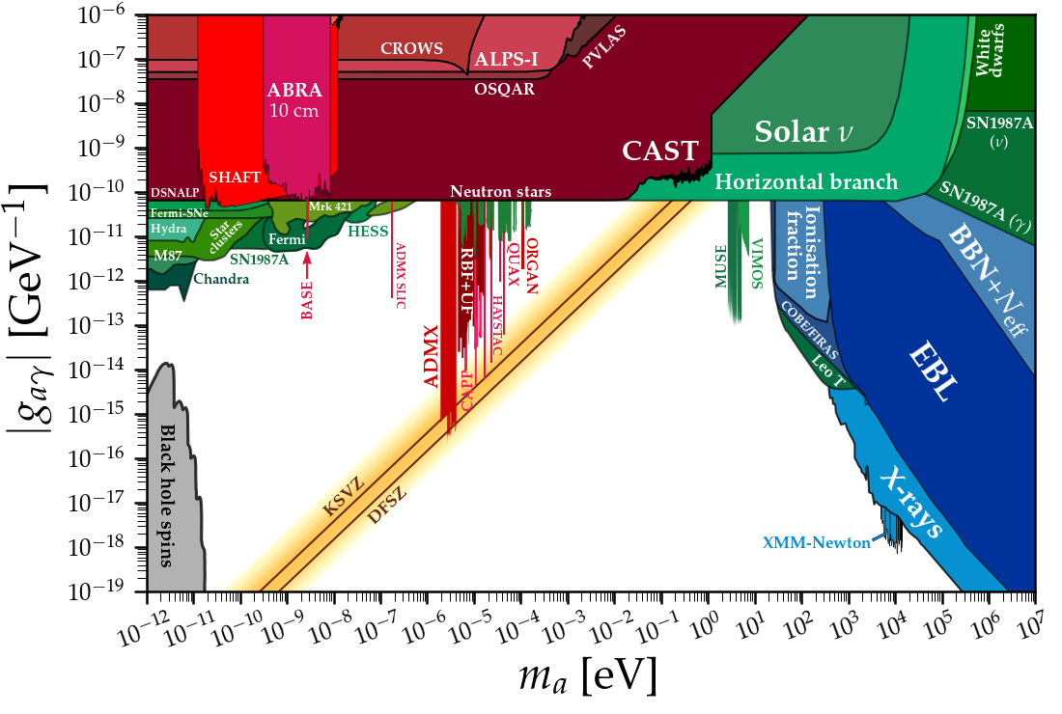
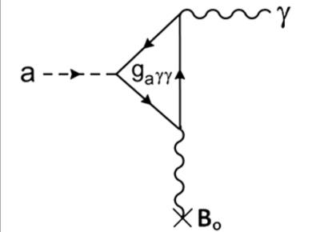
Axion Haloscopes
https://cajohare.github.io/AxionLimits/

Slide 3
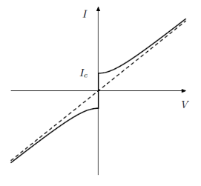
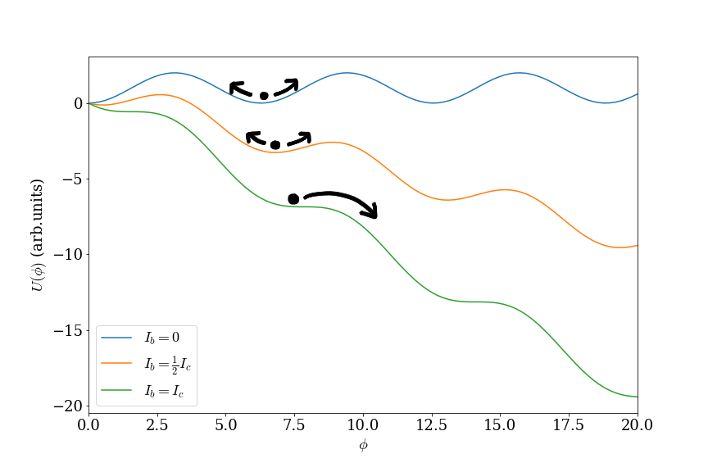
Current biased Josephson junctions

Slide 4
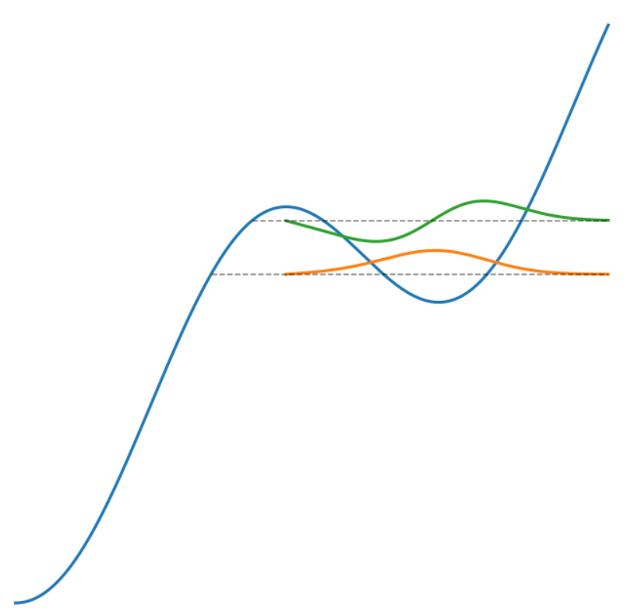
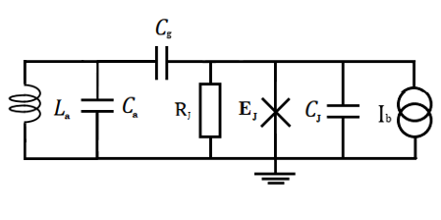
The photon counter

Slide 5
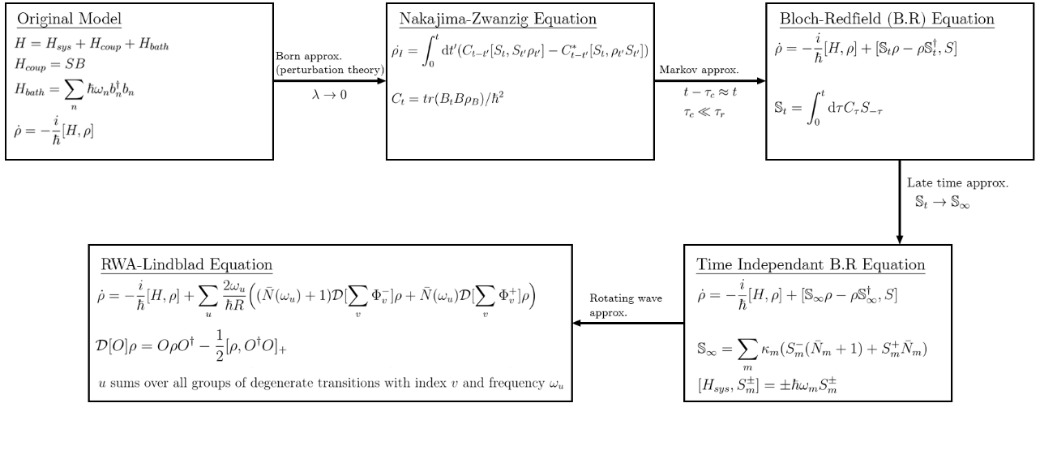
Master equations

Slide 6
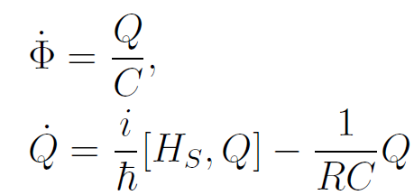
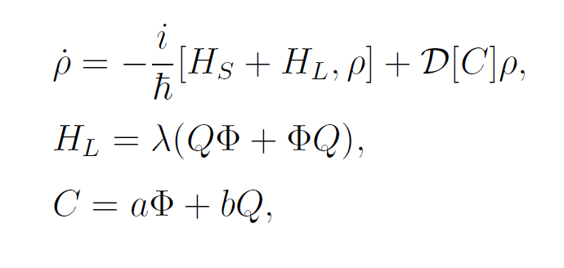
A phenomenological model?
Can we use a phenomenological model used previously
Langevin Equations:
Gibbs State:

Slide 7
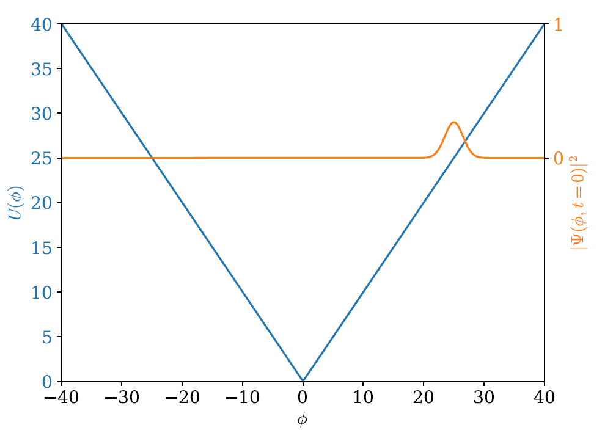
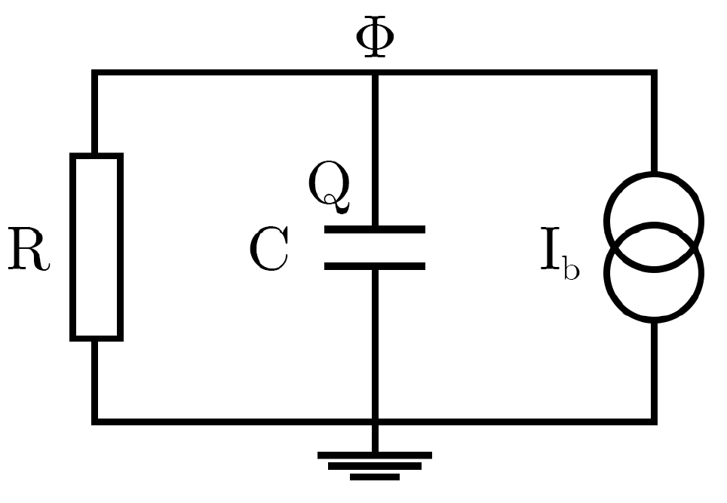
Test case: current biased RC circuit
The Overall Hamiltonian:
Initial State:
Circuit diagram:
Given some initial momentum corresponding to steady state momenta

Slide 8
Test Case

Slide 9
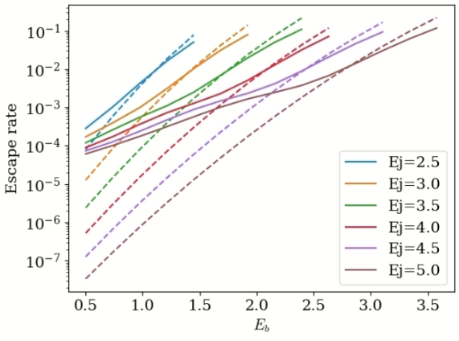
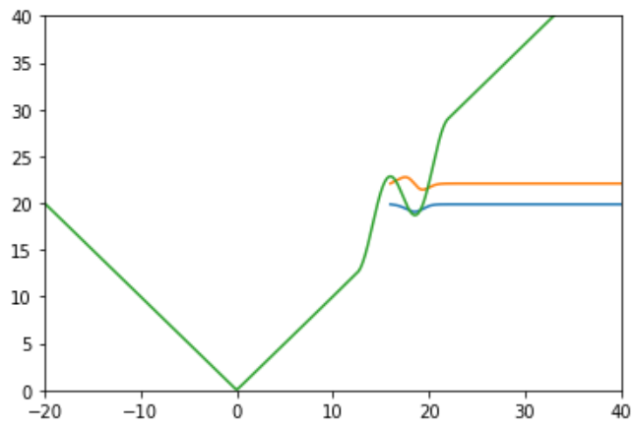
What about escape rates?
Simulation results
U(φ)
Junction energy
φ
MQT expected rates
Current bias (in units of energy)

Slide 10
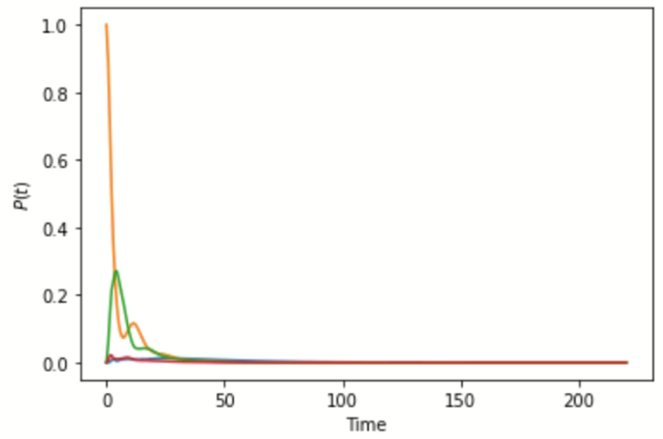
Coupled to a source of photons
Ground state, 1 photon in cavity
Excited state, 0 photons in the cavity
(ns)
Photon has left the well in ~30ns
Dark counts happen on time scale 300ns for this example plot, indicating dynamics are entirely due to incoming photon.

Slide 11
Outlook and future work
Phenomenological model seems to be only viable model which obeys ohms law and produces physical states.
Produces some errors in escape rates, however for short simulations (approx. <1us), it reproduces expected results.
This indicates it should still be valid for predicting efficiency of reacting to absorption of photons (which happen on shorter time scales for useful devices).
Next need to use the model to find optimal parameters for a real junction. Still need to use existing methods to find dark counts.

Slide 12
Extra Slides - Some past work
States guaranteed to have positive probabilities associated with measurements
Three essential properties:
Complete Positivity
Translational invariance of dissipation
Detailed balance
Pick Two!
Dissipative terms in EOMs are independent of position in potential
State will eventually settle in correct thermodynamic equilibrium

Slide 13
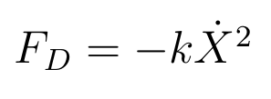
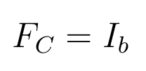
Translational Invariance of dissipation
The dissipater L is translationally invariant if for arbitrary operator Y:
But what does this mean…
X
Φ
Connection to quantum EOM: Ehrenfest Theorem

