Slide 1
Inelastic Boosted DM
Xuan-Gong Wang
The University of Adelaide
In collaboration with Bill Loizos, and Anthony Williams
CDMPP ECR Workshop, Geelong, Nov. 22, 2022

Slide 2
Outline
Boosted Dark Matter
BDM within the dark photon framework
Experimental prospect
Summary

Slide 3
Boosted dark matter

Slide 4
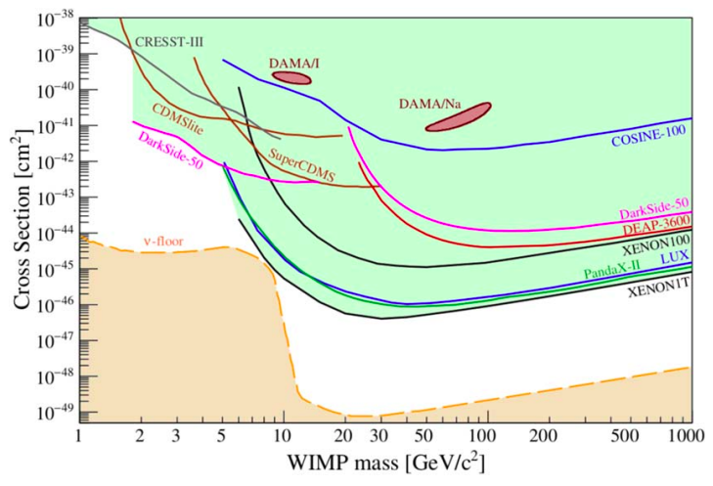
WIMP Direct Detection
NREFT
Anand, Fitzpatrick, Haxton, Phys. Rev. C 89, 065501 (2014)
Annual modulation
Freese, Lisanti, Savage, Rev. Mod. Phys. 85, 3495 (1986)
Stringent constraints from null experiments

Slide 5
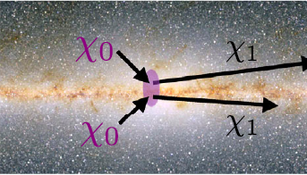
Boosted dark matter (BDM)

Slide 6
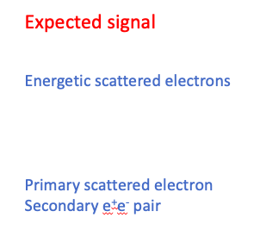
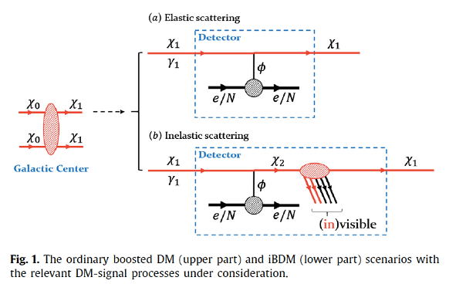
BDM Detection
Giudice, Kim, Park, Shin, Phys. Lett. B 780 (2018) 543

Slide 7
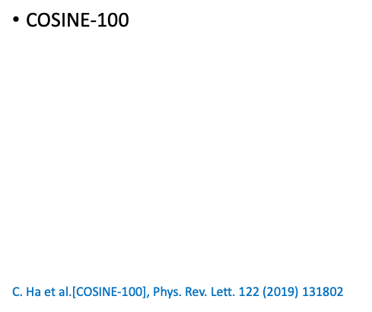
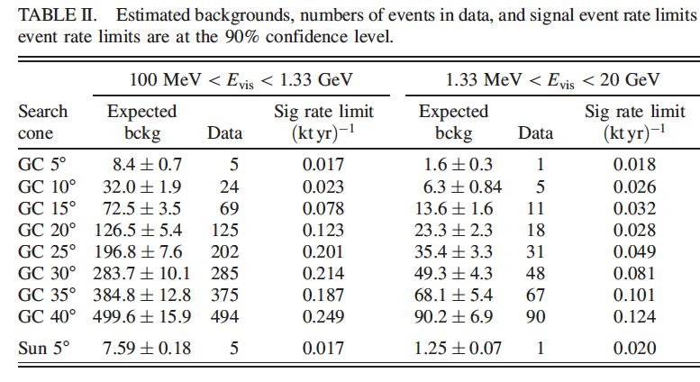
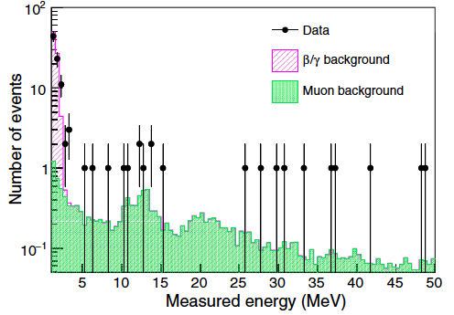
consistent with background hypothesis
21 events .vs. 16.4(2.1) background

Slide 8
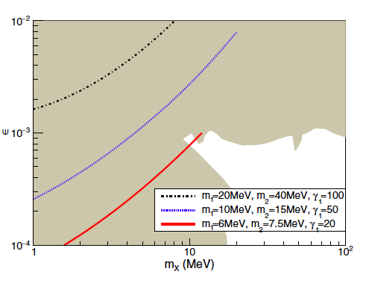
Theoretical Models for - SM
Giudice, Kim, Park, Shin, Phys. Lett. B 780 (2018) 543
Kim, Park, Shin, Phys. Rev. Lett. 119 (2017) 161801
C. Ha et al. (COSINE-100), Phys. Rev. Lett. 122 (2019) 131802

Slide 9
II. BDM within dark photon framework

Slide 10
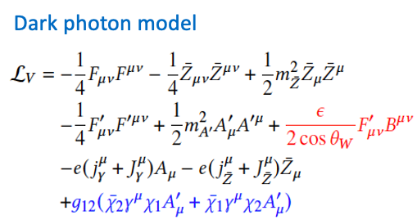
muon g-2
EWPO
DIS, Drell-Yan
rare kaon decay
parity-violation
W-boson mass
(poster)
L.B. Okun, Sov. Phys. JETP 56 (1982) 502
B. Holdom, Phys. Lett. 166B, (1986) 196

Slide 11
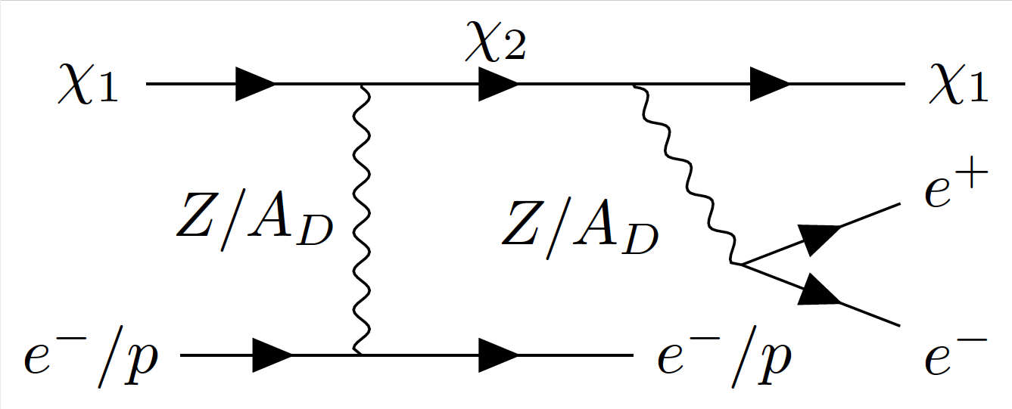
Dark Photon .vs. Minimal

Slide 12
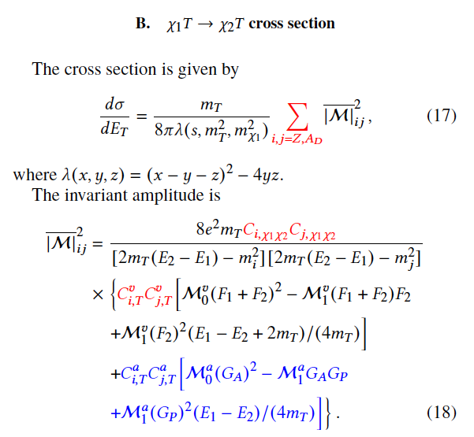
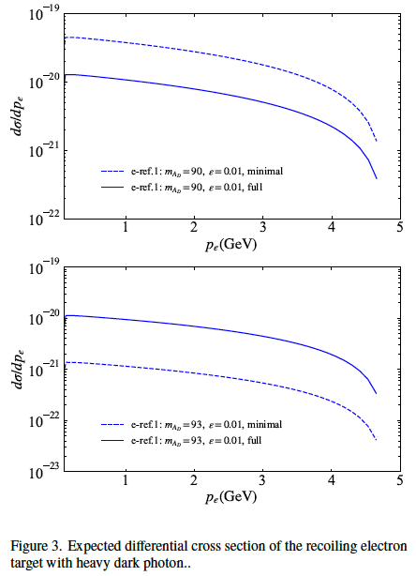

Slide 13
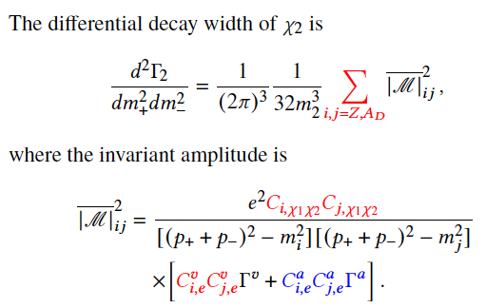

Slide 14
III. Experimental prospect

Slide 15
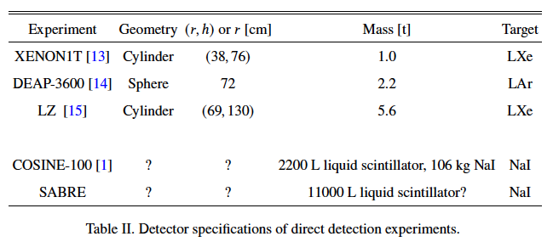
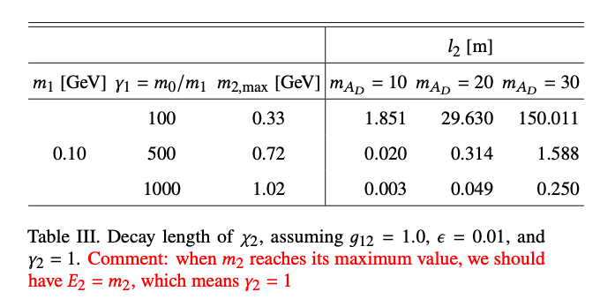
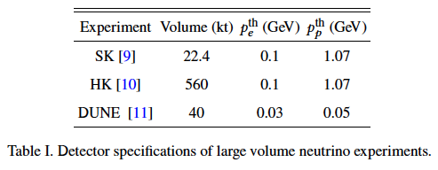
IBDM: decay length

Slide 16
Experimental sensitivity

Slide 17
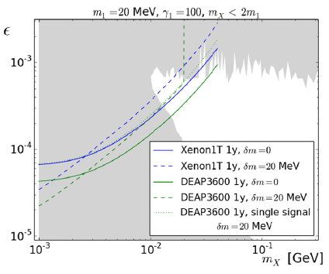
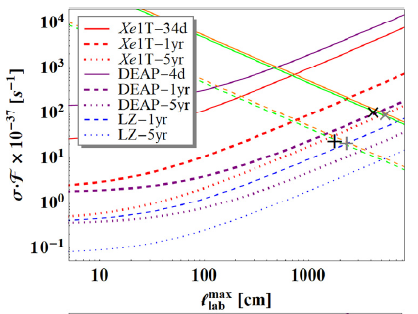
Exclusion limits
Giudice, Kim, Park, Shin, Phys. Lett. B 780 (2018) 543
The experimental sensitivity is set by demanding at least 2.3 events:

Slide 18
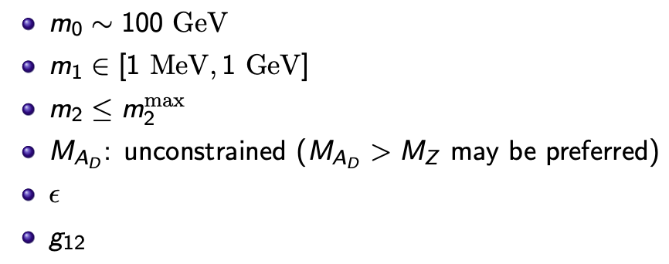
SABRE Sensitivity
Z-boson invisible decay

Slide 19
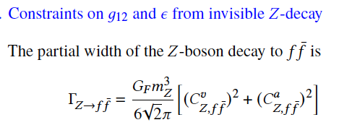
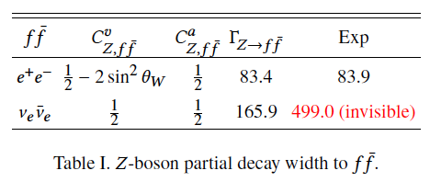
Within the dark photon framework,
We require
SM

Slide 20
IV. Summary

Slide 21
Summary

