Slide 1
Consequence of neutron decay inside neutron stars
Wasif Husain
The University of Adelaide

Slide 2
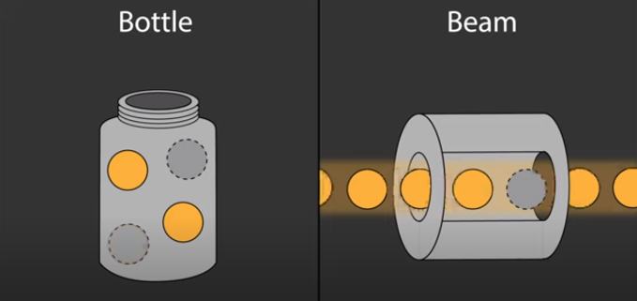
Neutrons lifetime
Neutrons decay shows different lifetimes when measured using different methods.

Slide 3
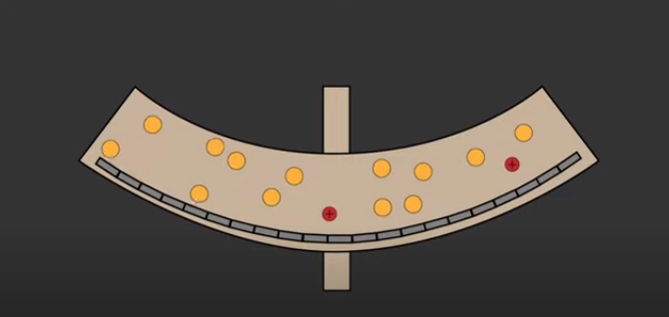
Bottle method
The lifetime of neutron in a bottle is measured by counting the number of neutron remains after a while. Lifetime = 879.6±0.6 sec

Slide 4
Beam method
The lifetime of neutron in a beam method is measured by counting the number of proton produced. Lifetime = 887.9±0.5 sec

Slide 5
Neutrons decay puzzle: Difference in lifetime
The lifetime of neutron in beam method: 887.9±0.5 sec
The lifetime of neutron in bottle method: 879.6±0.6 sec
The difference between the two methods always remain about 8 sec.
May be neutrons have other decay channel?

Slide 6
Neutrons dark decay
Fornal and Grinstein hypothesis: Neutrons decay into dark matter and a boson.
The dark matter beam goes undetected in the beam method while its effects is counted in bottle.

Slide 7
Neutron stars: Good laboratory to test the decay
Has abundance of neutrons
If neutrons decay into dark matter than neutron star must have dark matter at the core.
Presence of dark matter should change the neutron star properties.
The neutron star properties can be tested against the constraints of neutron stars.

Slide 8
Constraints on neutron stars
Mass: Maximum mass of neutron star must be at least 2 solar masses.
Radius of neutron star of mass 1.4M must be 10-13 Kms.
Neutron star of mass 1.4M must have a tidal deformability between 70-585.

Slide 9
Model the NS: Matters inside the neutron stars
Two fluids are inside the neutron stars.
Nuclear matter
Dark matter
It is assumed that dark matter is not interacting with nuclear matter.
Dark matter is self-repulsive. Interaction similar to neutron-omega interaction is considered.

Slide 10
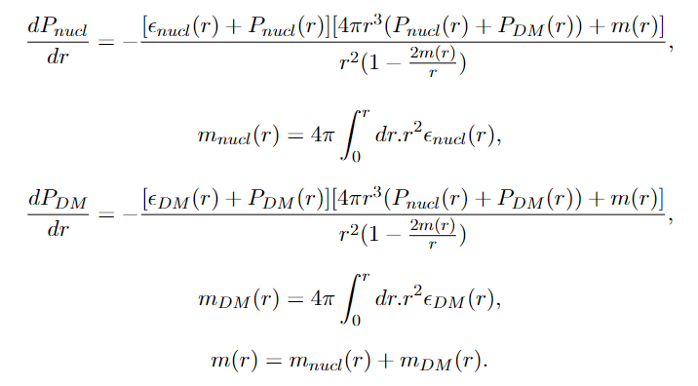
Equations to model the NS
Equation of state for nuclear matter (nucleons only)
Equation of state for DM
Structural equations: Two fluid TOV equation.

Slide 11
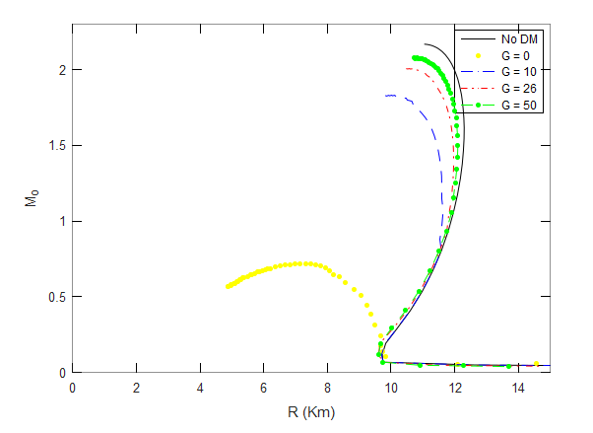
Consequences of neutron decay into DM
Mass vs Radius

Slide 12
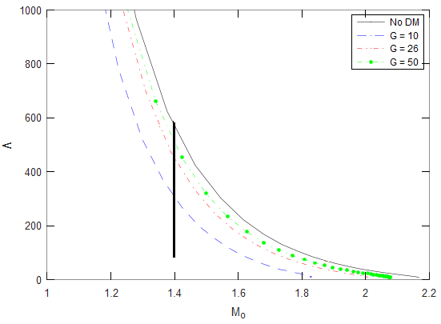
Consequences of neutron decay into DM
Mass vs Tidal deformability

Slide 13
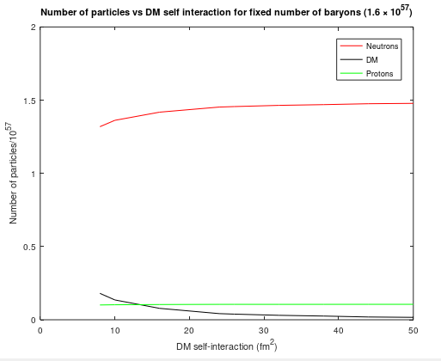
Consequences of neutron decay into DM
Baryons population vs DM self-interaction

Slide 14
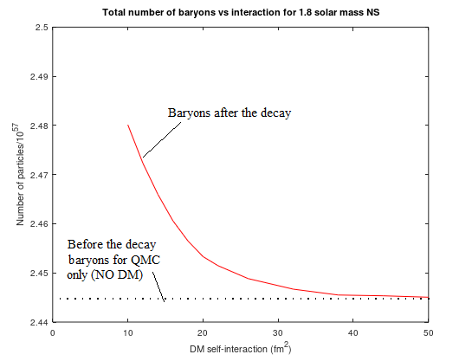
Consequences of neutron decay into DM
Number of baryons vs DM self-interaction with fixed NS mass.

Slide 15
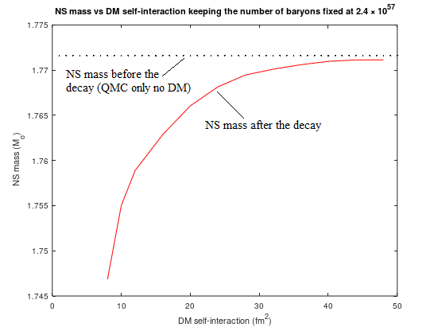
Consequences of neutron decay into DM
Mass vs DM self-interaction with fixed total number of baryons.

Slide 16
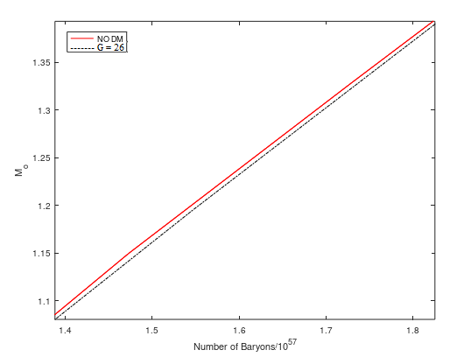
Consequences of neutron decay into DM
Mass of NS before and after the decay vs Number of baryons

Slide 17
Possible signal of neutron decay into DM
Assuming some of the energy is emitted as boson.
Neutron star must heat up, either nuclear matter or DM.
Heating and change of spin.

Slide 18
Signal of neutrons decay into DM
If neutrons decay into dark matter than dark matter must be strongly self-interacting, with self-interaction must be at least 26 fm².
The decay must reduce the radius of neutron star and there must be a change in the spin of neutron star.
Due to decay the neutron star must heat up either the nuclear matter or the dark matter.

Slide 19
Thank you
Any Questions!

