Slide 1
Education Update – Regional Schools

Slide 2
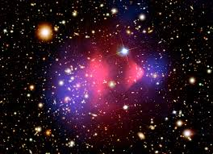
Why Dark Matter in Education
Encapsulates the Nature of Science and Scientific Inquiry
Broad Science content – galaxies, gravity, particles
Connections with labs and scientists – work here in Australia
Fascination!

Slide 3
Why collaborate with regional schools?
From the perspective of schools (provided by Stawell Secondary):
Regional schools limited by geography and resourcing
Great opportunity to expose students to cutting edge science
Regional areas may well need to cultivate science in areas such as agriculture, reviewable energies etc
Creates level field with teachers and students
Challenges as regional students don’t find it easy to adapt to the big city
Highly relational involvement, not just a gizmo in the mail.
It’s about the learning and real outcomes

Slide 4
Why this collaboration?
From the CDM Perspective
Highlight STEM pathways for students
Increase PD opportunities and resources for Regional Teachers
Provide relatable role-models for students, especially girls
Bring science to regions and inspire with science happening locally
Access of STEM programs to underserved schools
Opportunity to build in engagement happening locally
Build an understanding of the importance of big science for society
Opportunities to study impact of centre-led education programs

Slide 5
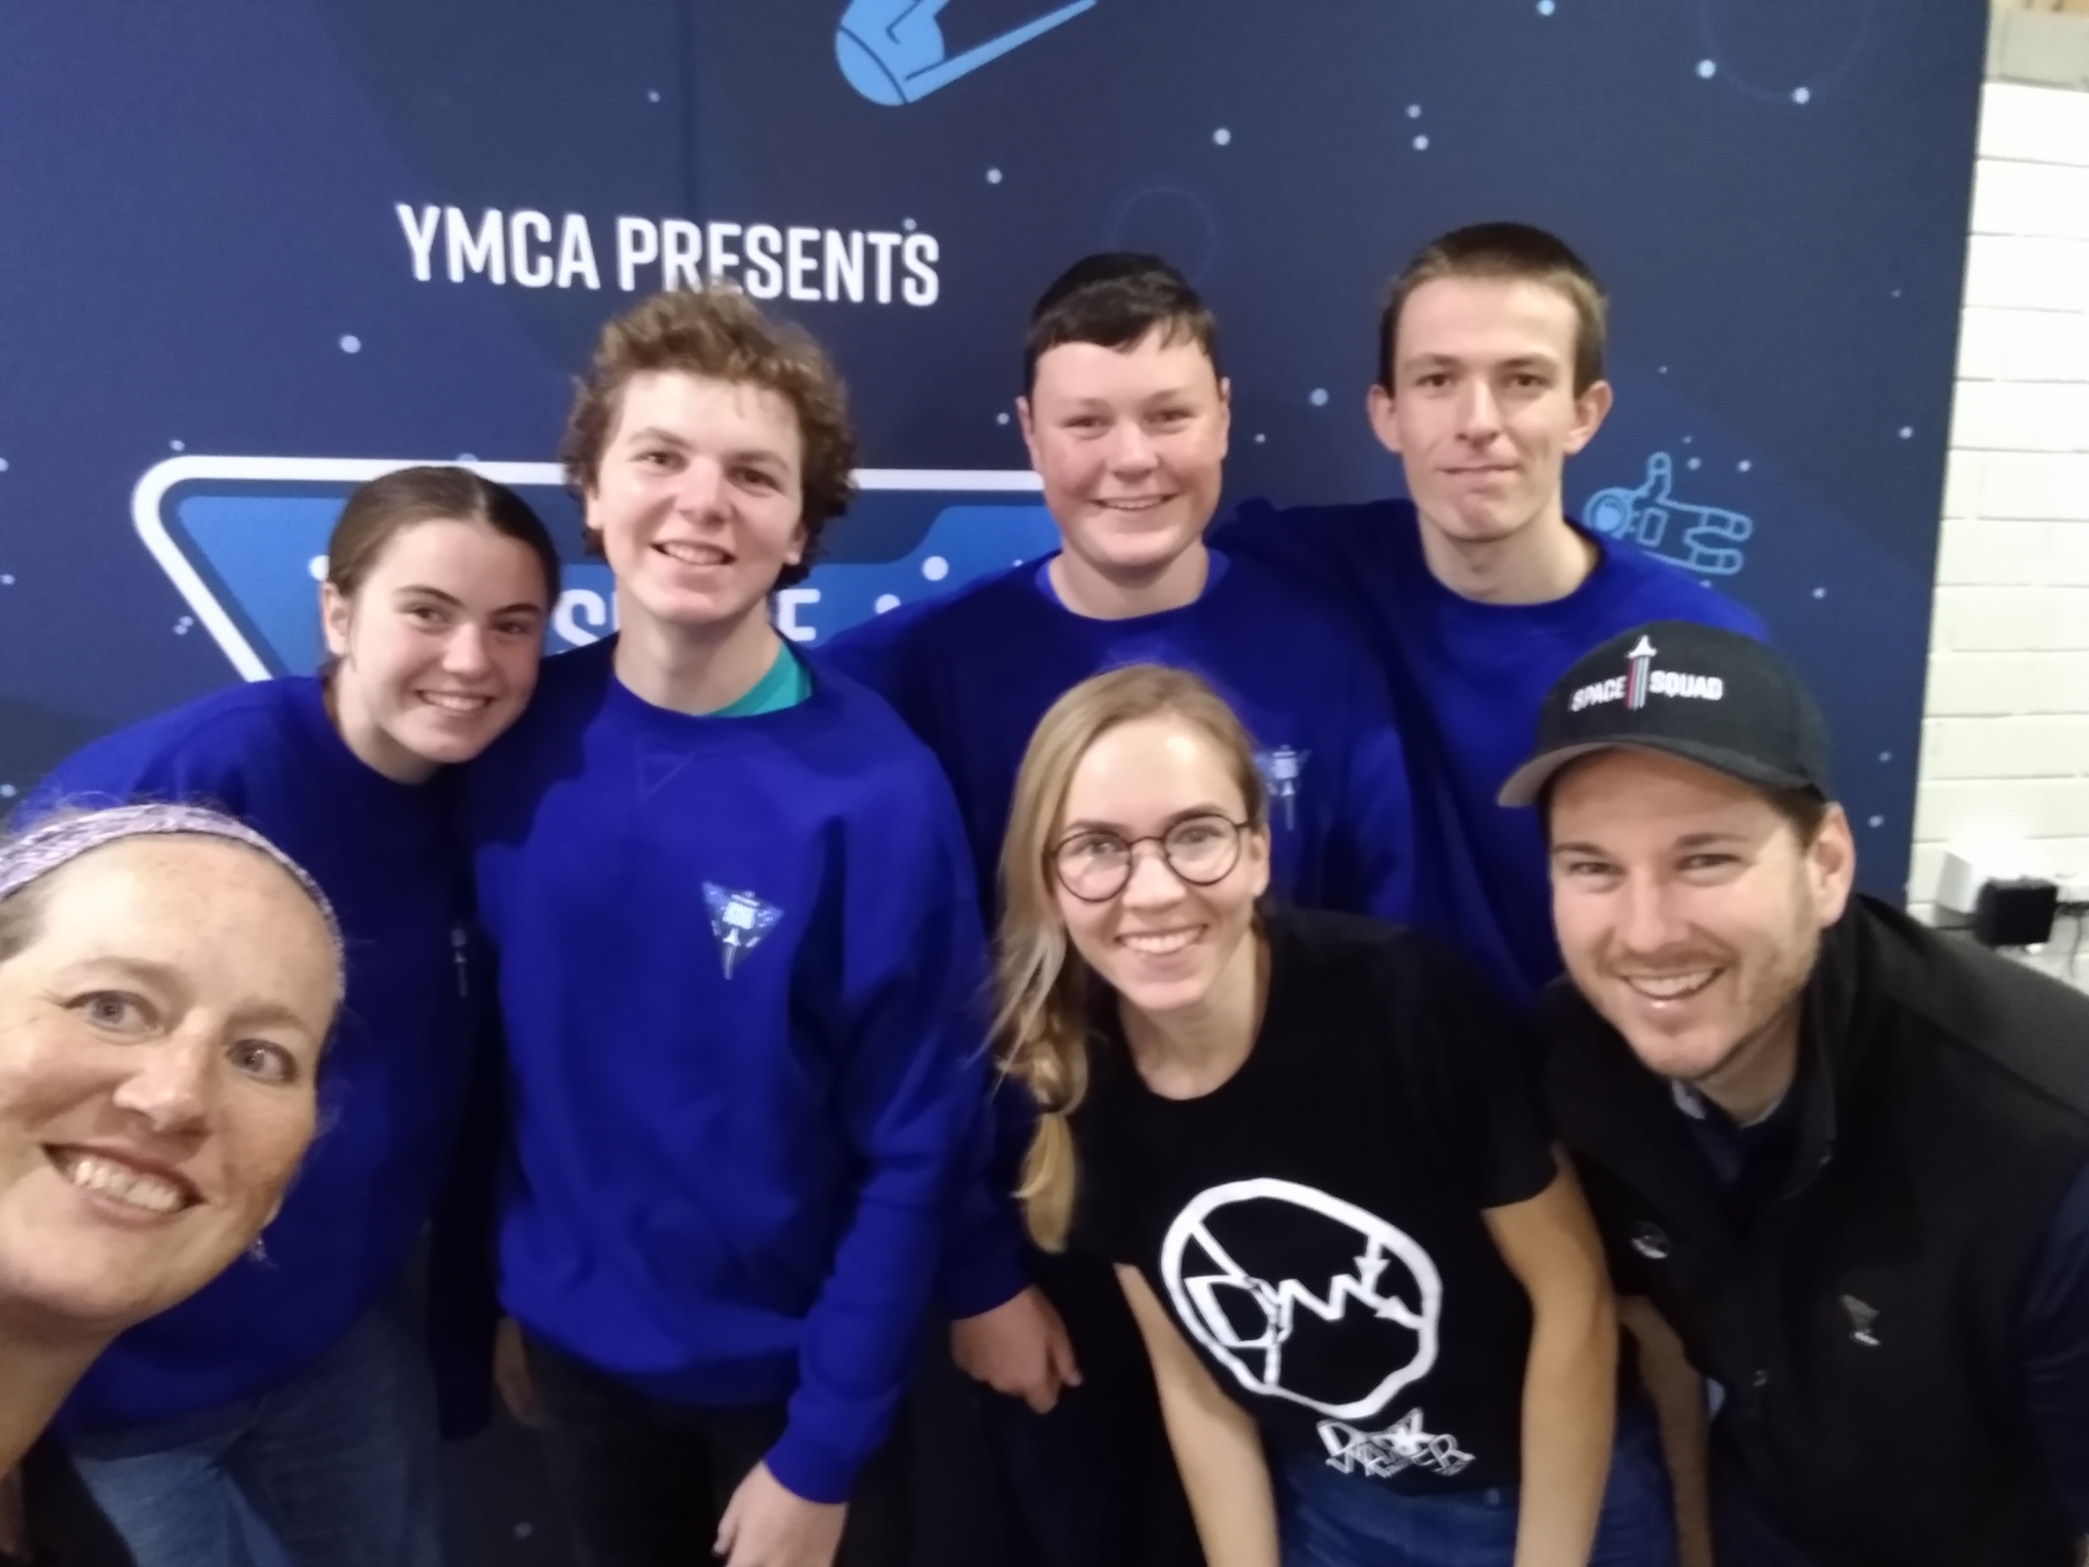
What are we doing together?
Creating Dark Matter Partner Schools
High-impact, long-term engagement with partner schools
Longitudinal, Relevant, Measurable Impact
Leverage partnerships to incorporate unique experiences for students and teachers
Target opportunities for regional students and teachers
Create content to continually be used by teachers
Diverse cohort of centre scientists engaging with students

Slide 6
How are we doing this?
Learning From Others: Additional Resources
Curriculum Alignment: Lessons
Creativity: Design activities, Arts, and Innovative Design
Nature of Science: Mystery Box Activity as an example

Slide 7
How are we doing this? Learning from Others with Existing Resources
CERN S’Cool Lab: Mystery Boxes; Jelly Lenses; Particle Quiz; Cloud Chambers
Perimeter Institute
Sanford Underground Lab
Credo Detector Project
Dark Matter Day

Slide 8
How are we doing this? Curriculum Alignment
Lessons we have developed or are modifying are aligned across Years 7-10 and Physics
Topics included:
Gravitation
Rotation
Light and lensing
Nature of Science
Atomic structure
All curriculum aligned and delivered in conjunction with science teachers

Slide 9
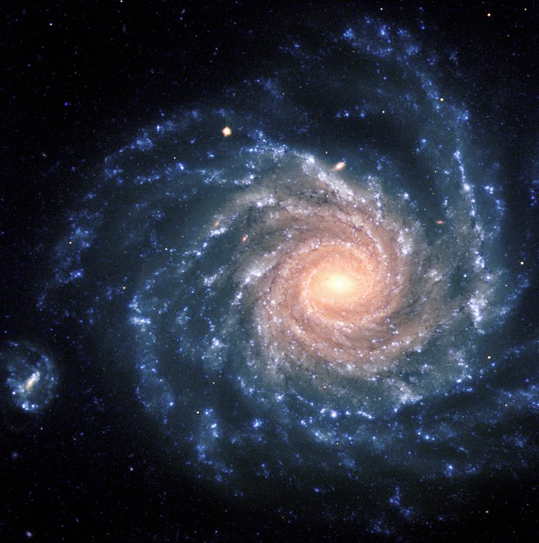
How are we doing this? Creativity
Dark Matter Scientists are creative! They study the world around us from the large scales of galaxies to the smallest particles.

Slide 10
Creativity: Design Inspiration
The Dark Matter Centre partners with the Design Factory Melbourne to create a Design Innovation workshop for secondary students, using research technology to inspire ideas to meet UN Sustainability goals.

Slide 11
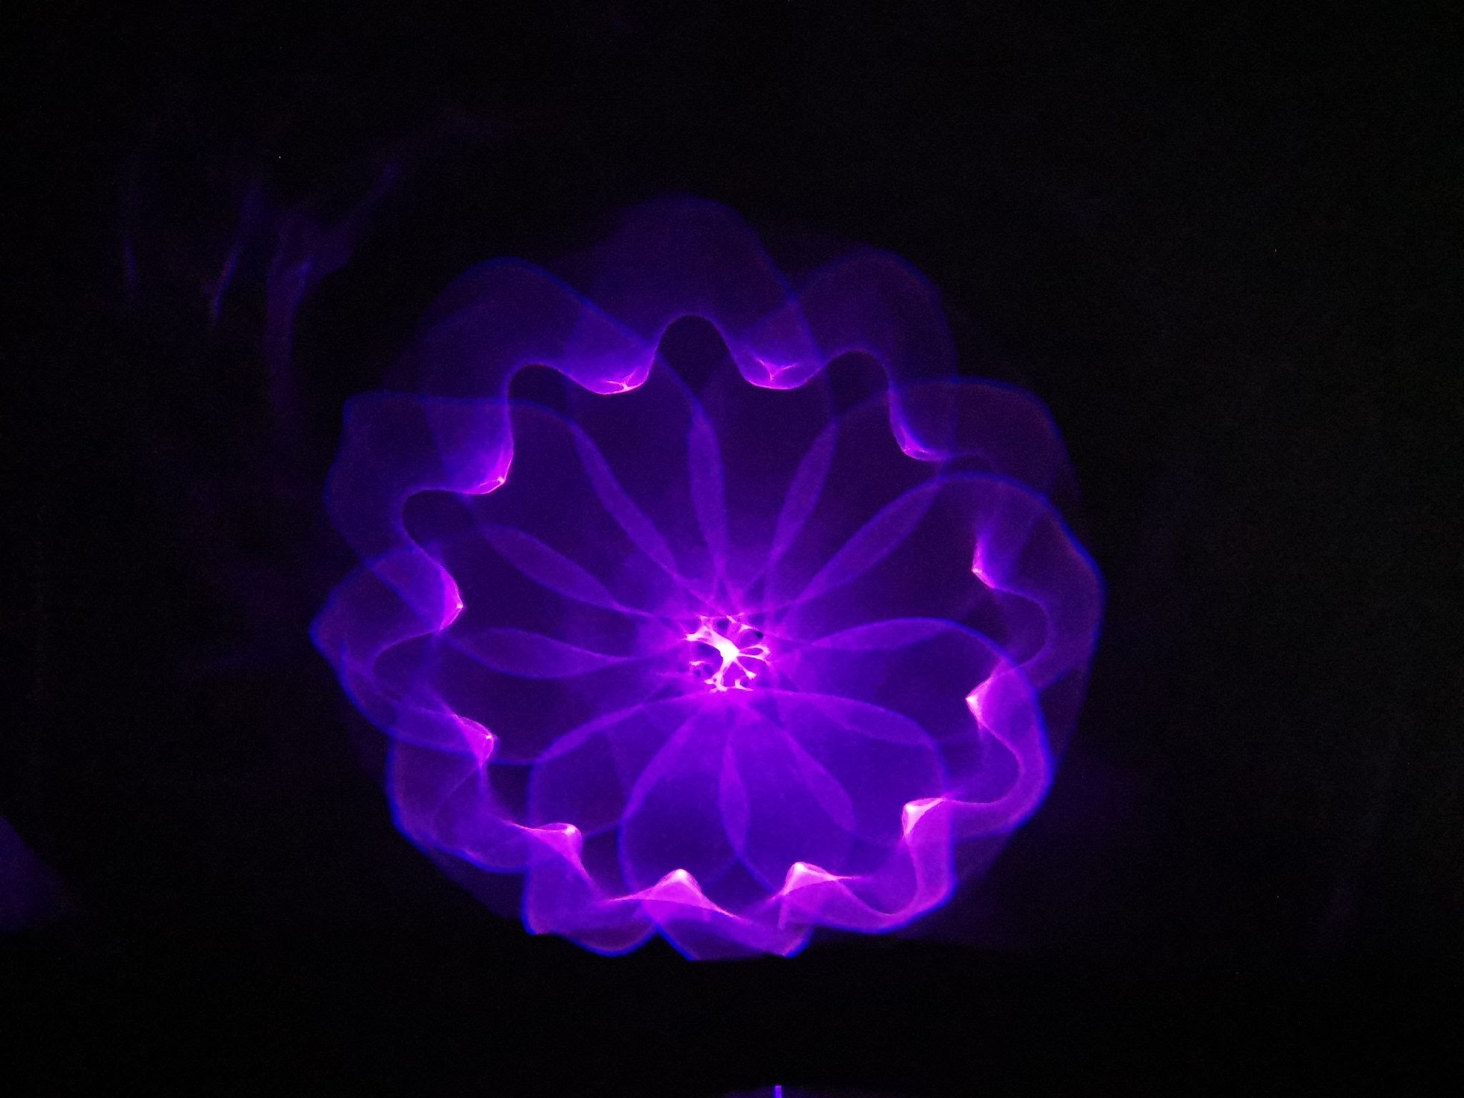
Creative Activity: Light and Art
Scientists use light to learn about what they can and cannot see in the Universe.
Art activities inspired by science invite a greater variety of students to a lesson.
Raghda at ANU has created an amazing SciArt activity for school students

Slide 12
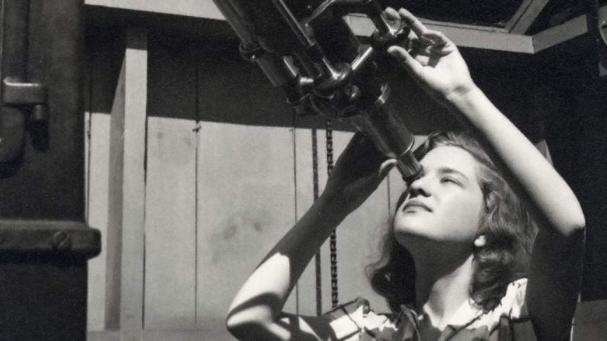
How are we doing this? Nature of Science
Science is no longer the realm of the lone genius but rather is a collaborative effort.
Similarly, it doesn’t always follow the traditional scientific method, but rather relies on making observations to create a model.

Slide 13
How are we doing this? Nature of Science – Mystery Boxes
Activity developed by CERN’s S’Cool lab
Using 3-D printed boxes with various patterns inside
Students need to use senses beyond sight… and possible other tools!... To determine what is inside

Slide 14
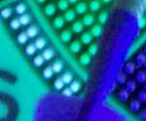
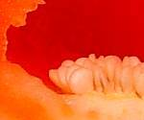
Virtual Activity: Mystery Photos
Each photo shows a magnified portion of a larger object
For each photo:
Observe: Work with a partner to create a list of observations
Model: Based on these observations, determine with your partner a best guess of what object is – ensure you are consistent with your observations!
Communicate: Talk with another set of students to share your ideas
Collaborate: Come to a consensus together about what the object is
https://sciencespot.net/Pages/startersgensci.html

Slide 15
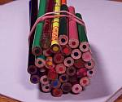
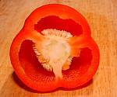
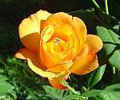
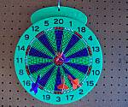
The Answers:

