Slide 1
Exploring the cosmological dark matter coincidence with infrared fixed points
Alex Ritter

Slide 2
Overview
The cosmological coincidence problem
Approaches to resolving the coincidence problem
Dark QCD and infrared fixed points
Concluding remarks

Slide 3
The cosmological coincidence

Slide 4
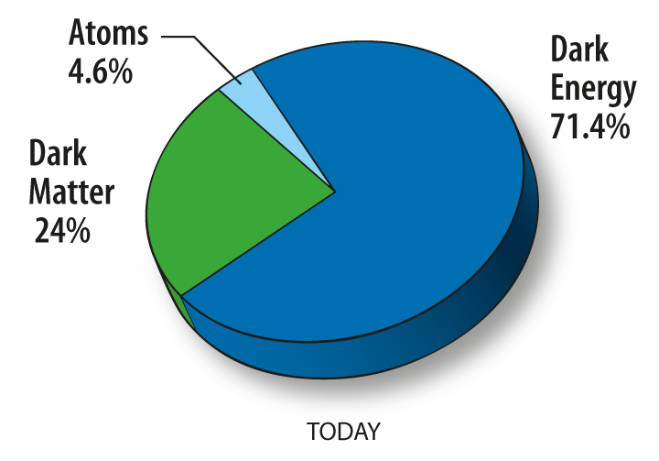
The cosmological coincidence
Large range of DM candidates
Axions, WIMPs, sterile neutrinos, PBHs…
How to guide our model building?
Clues from current observational evidence:
Apparent coincidence between the present-day cosmological mass densities of dark and visible matter
https://wmap.gsfc.nasa.gov/universe/uni_matter.html
Planck 2018, arXiv: 1807.06209

Slide 5
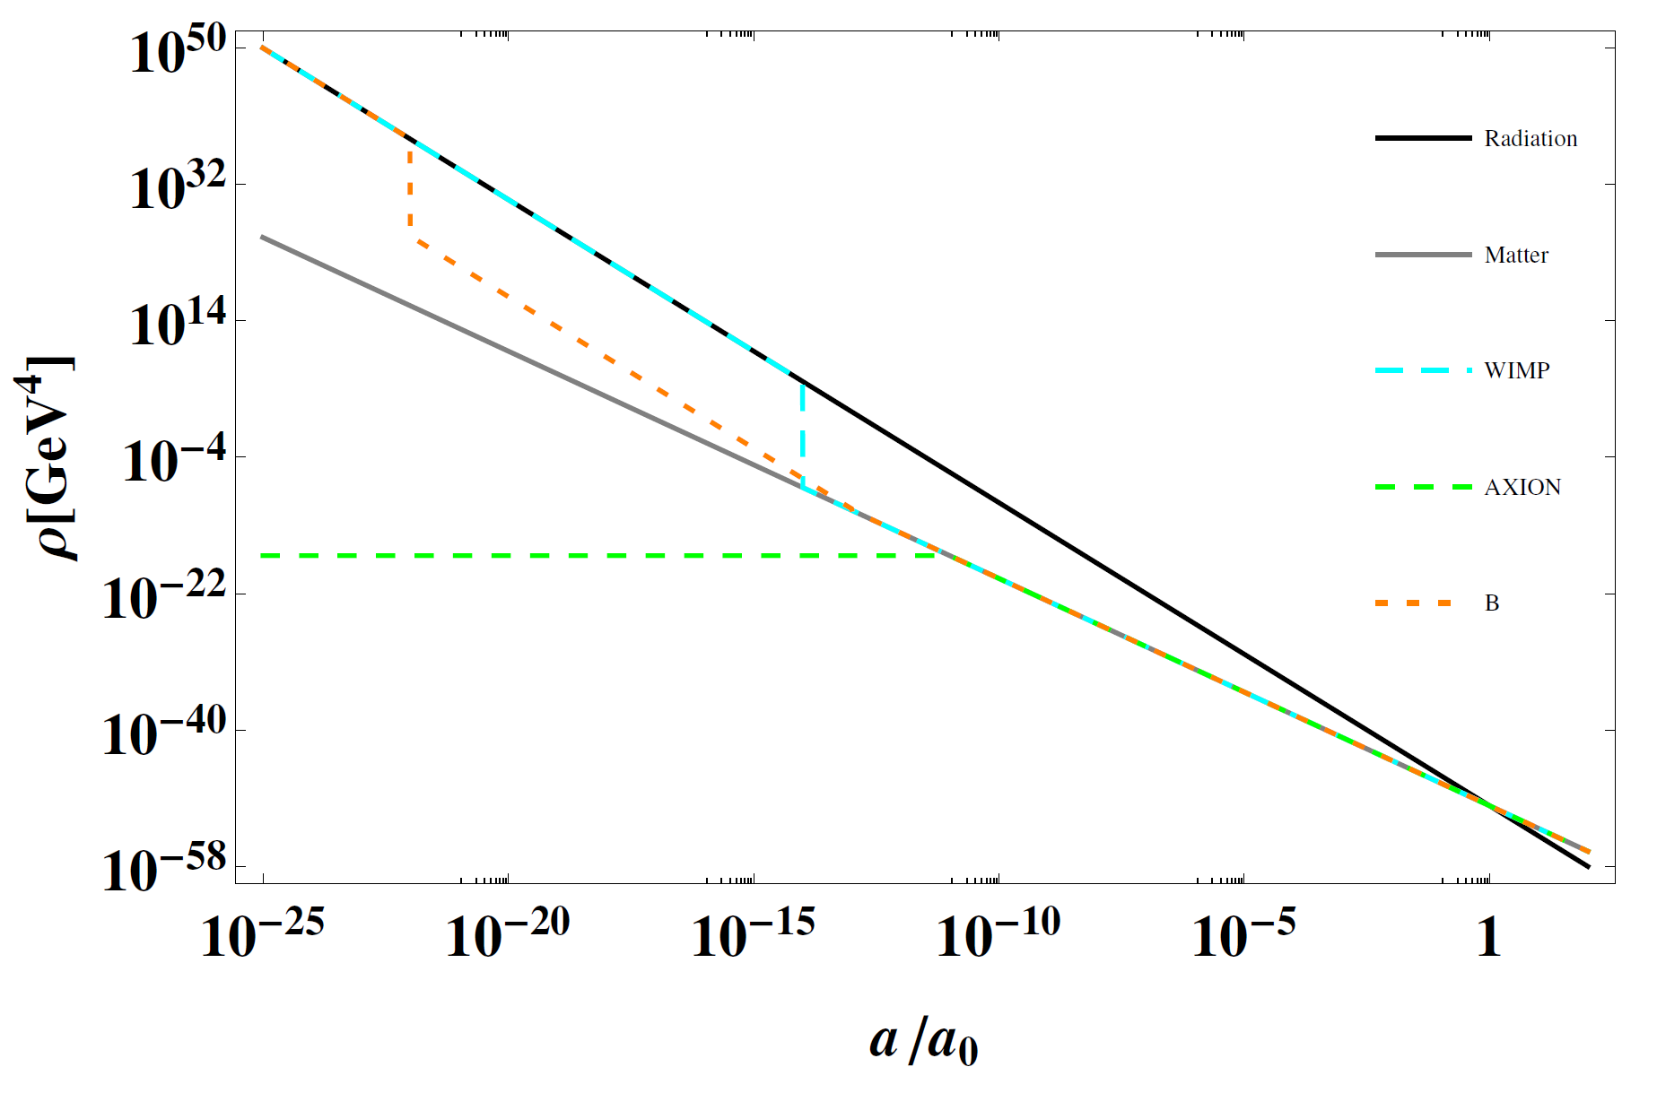
Why is it a coincidence?
The cosmological mechanisms responsible for the mass density of visible baryons and most dark matter candidates are unrelated
Visible baryons result from a baryon-antibaryon asymmetry generated through an unknown baryogenesis mechanism
WIMPs result from thermal freeze-out
Axions result from the misalignment mechanism
A priori we would not expect the dark and visible mass densities to be on the same order of magnitude
Stephen J. Lonsdale, Thesis (2018)

Slide 6
How do we explain this coincidence?
A similarity such as this often derives from some deep underlying connection
e.g. electric charge neutrality of the universe ⇒ $n_{p^{+}}=n_{e^{−}}$
The coincidence problem has two distinct parts:
Relating number densities
Relating particle masses
Our goal is to build models in which the mass densities of visible and dark matter are naturally of a similar order of magnitude

Slide 7
Approaches to resolving the coincidence problem

Slide 8
Relating number densities - ADM
The visible number density: asymmetry between baryons and antibaryons (or a nonzero baryon number $B_{V})$
In Asymmetric Dark Matter models there exists a similar asymmetry in a dark baryon number $B_{D}$
Wide range of ADM literature where
Most ADM models do not motivate
These are not satisfactory explanations of the coincidence problem
proton
critical

Slide 9
Relating particle masses
The visible baryon mass arises from the QCD confinement scale $Λ_{QCD}$
We consider dark matter candidates that are baryon-like bound states of a QCD-like confining gauge group $SU(N_{d})$
To relate the particle masses the confinement scales must naturally be of the same order
There are two main ways to achieve this:
Introduce a symmetry between ${SU(3)}_{C}$ and $SU(N_{d})$
Exact: Foot (2004) [astro-ph/0407623]
Carefully broken: Ritter, Volkas – PRD104 (2021) 035032 [2101.07421]
The gauge couplings of the two groups can evolve to some infrared fixed point

Slide 10
Dark QCD and infrared fixed points

Slide 11
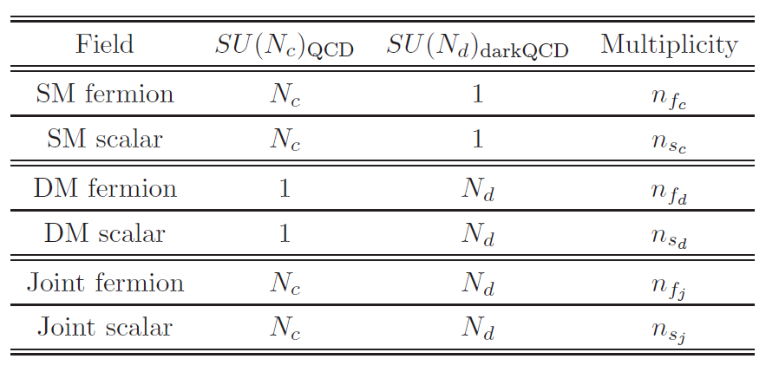
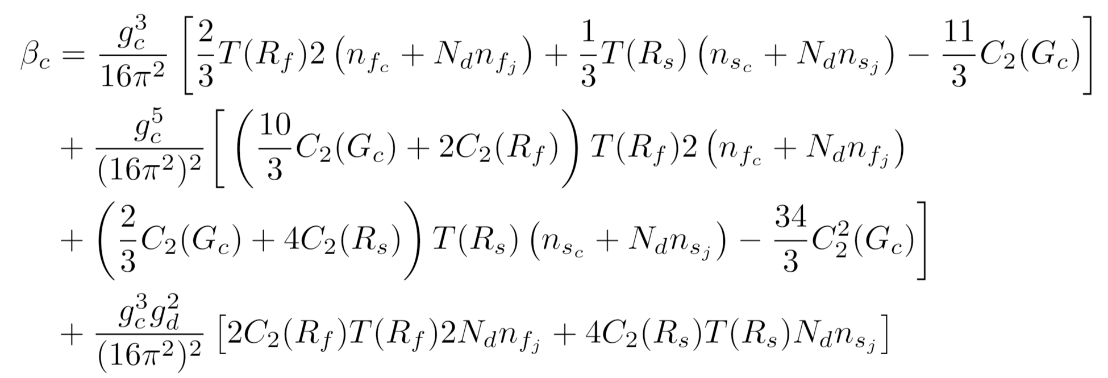
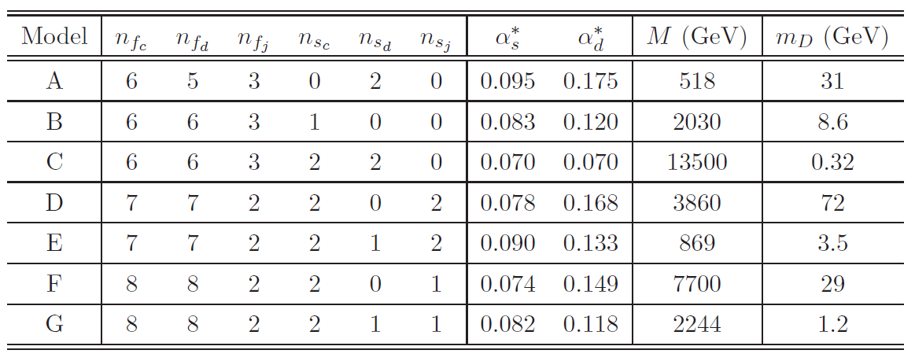
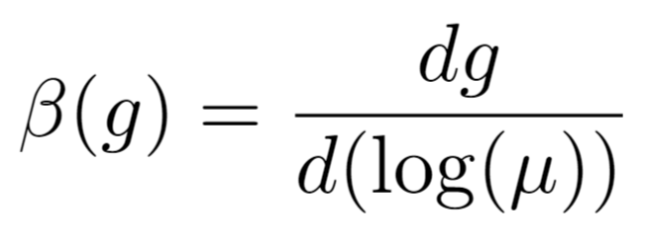
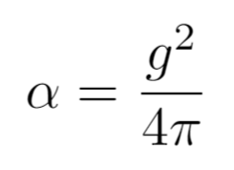
Dark QCD and infrared fixed points
Bai and Schwaller (2013) [1306.4676]
To relate confinement scales, only need to relate coupling constants in the IR
Introduce a dark confining gauge group and new field content, including bifundamentals
Obtain coupled two-loop beta functions for $g_{c}$ and $g_{d}$
The infrared fixed point ($α_{s}^{∗}$, $α_{d}^{∗}$) of a given model (selection of field content) is defined by
Tables from Bai, Schwaller [1306.4676]

Slide 12
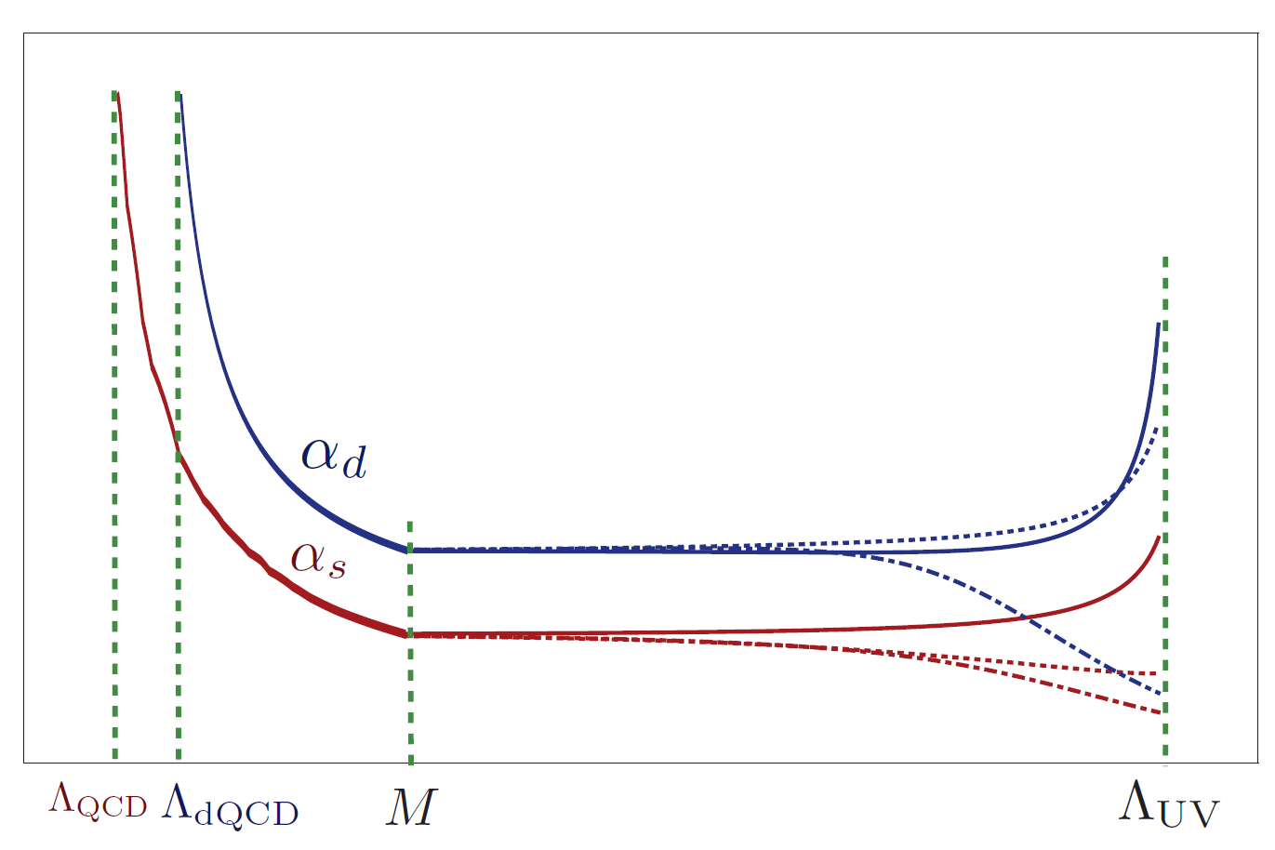
Bai-Schwaller model
All new fields have a mass $M≳m_{t}$ except for the dark fermions.
So, for a given model:
the coupling constants evolve to the fixed point ($α_{s}^{∗}$, $α_{d}^{∗}$) regardless of their initial value in the UV
The decoupling scale $M$ is determined by matching the running of $α_{s}$ below $M$ with experiment
The dark confinement scale $Λ_{dQCD}$ is then determined by running $α_{d}$ until it reaches a value of $π/4$
General idea:
model $⇒\text{(}α_{s}^{∗}\text{, }α_{d}^{∗}\text{)}⇒M⇒$ $Λ_{dQCD}$
Calculate dark matter particle mass from ${m_{D}≃1.5Λ}_{dQCD}$ for each model (selection of field content)
π/4
$$α_{d}^{∗}$$
$$α_{s}^{∗}$$

Slide 13
Threshold corrections
Bai and Schwaller assumed no threshold corrections
They were implemented by Newstead and TerBeek [1405.7427]
When decoupling the heavy fields, need to match the full theory onto the low energy EFT to obtain the correct running of the couplings constants .
Matching is performed at a decoupling scale $μ_{0}$ and is governed by the consistency condition:
New physics mass scale $M$ no longer uniquely determined for a given model
New general idea: model, $M$ $⇒μ_{0}⇒$ $Λ_{dQCD}$
π/4
$$α_{d}^{∗}$$
$$α_{s}^{∗}$$

Slide 14
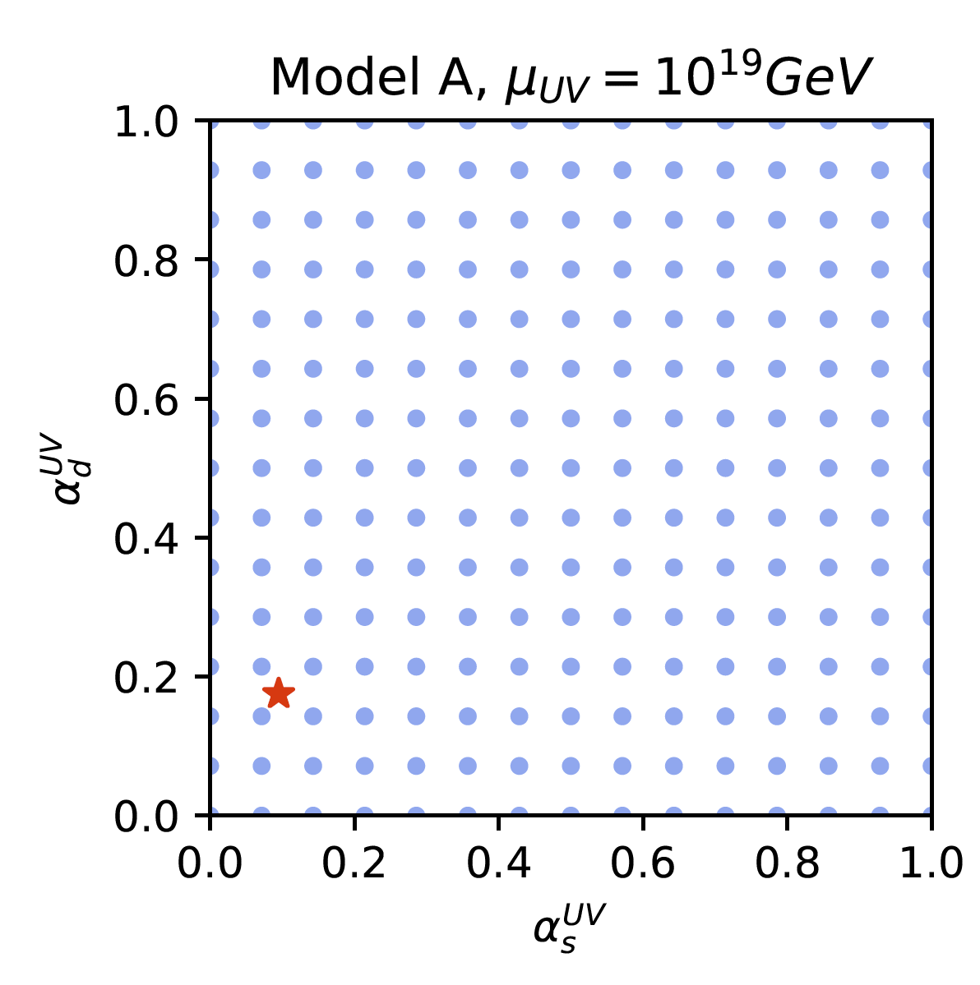
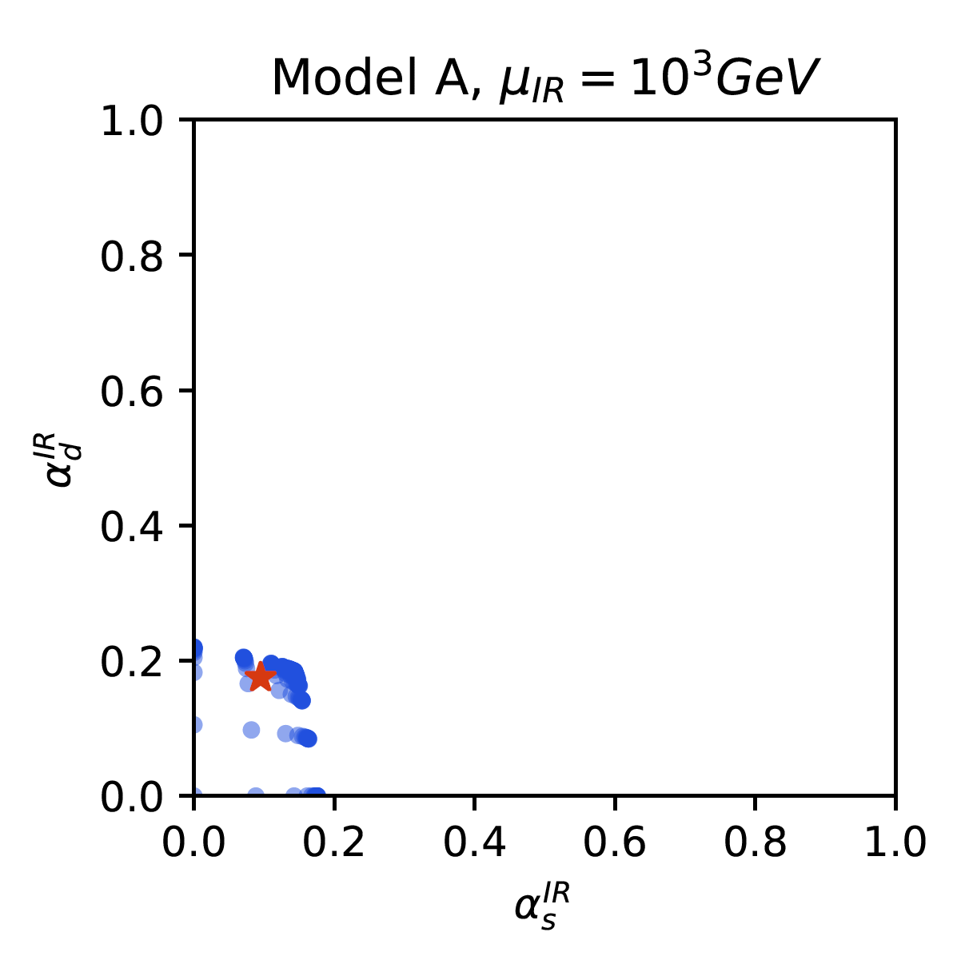
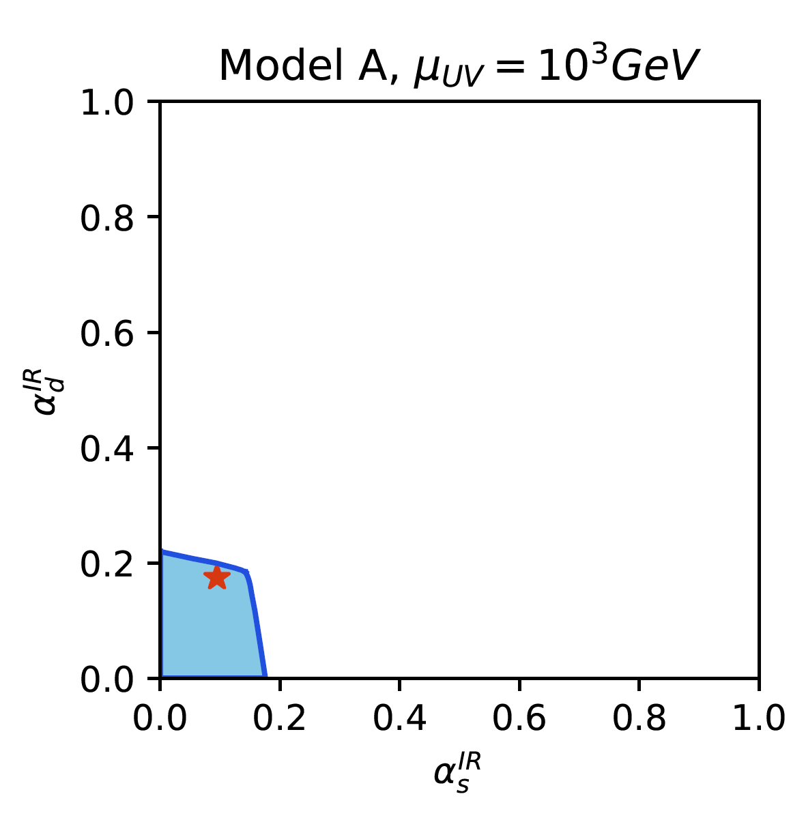
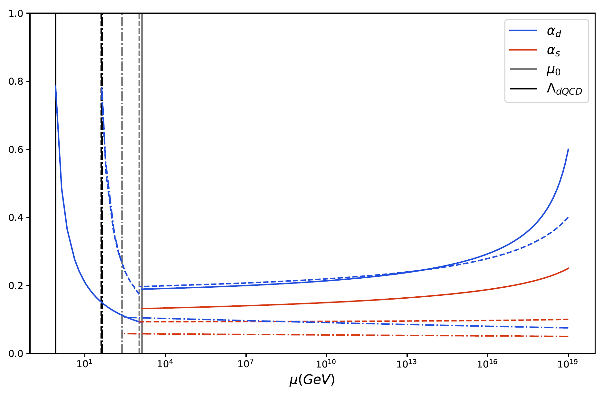
Initial conditions in the UV
Bai and Schwaller also assumed that the couplings would always reach the IRFP by the decoupling scale $M$, regardless of the initial UV conditions ($α_{s}^{UV}$, $α_{d}^{UV}$)
This is not true in general
we plot this for points satisfying $0<$ $α_{s}^{UV},α_{d}^{UV}<1$
New new general idea: model, $M$, ($α_{s}^{UV}$, $α_{d}^{UV}$) $⇒μ_{0}⇒$ $Λ_{dQCD}$
Model A, $M={10}^{3}GeV$

Slide 15
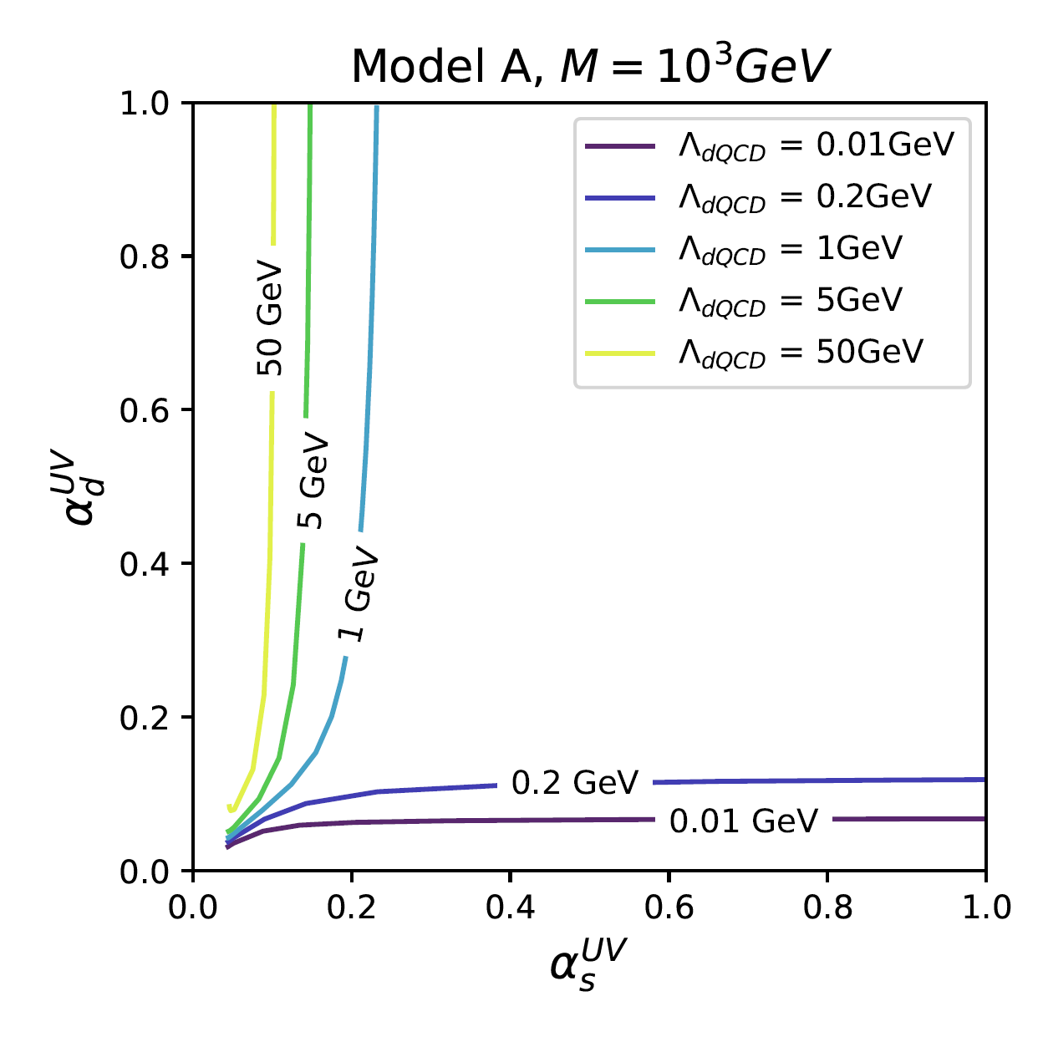
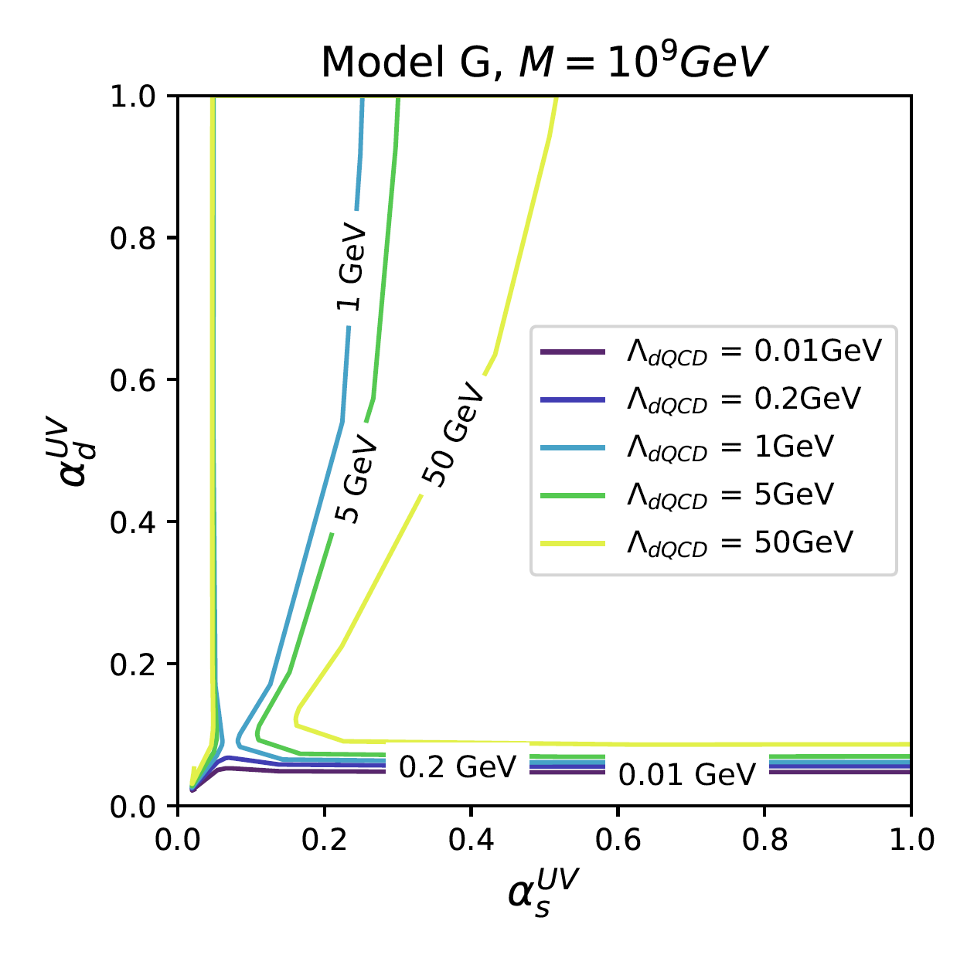
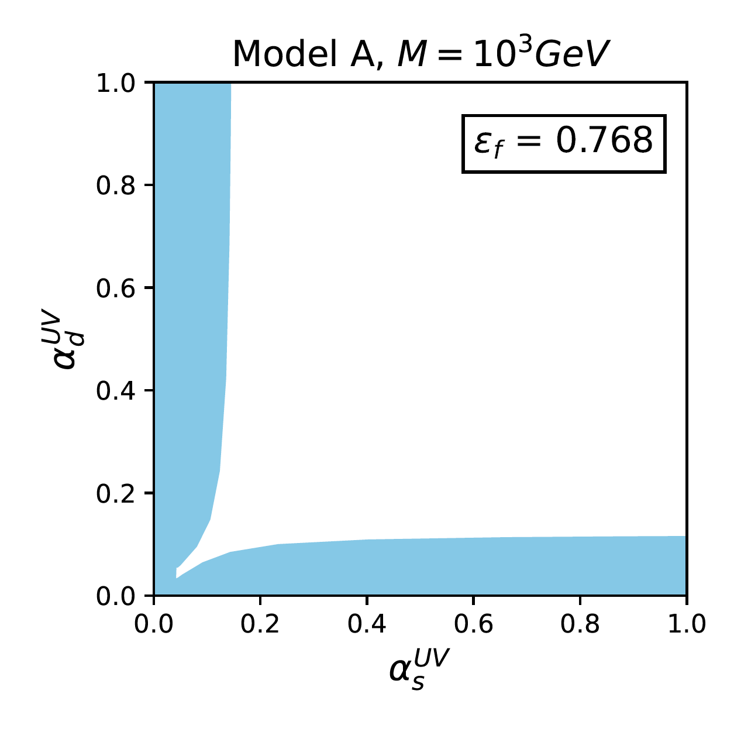
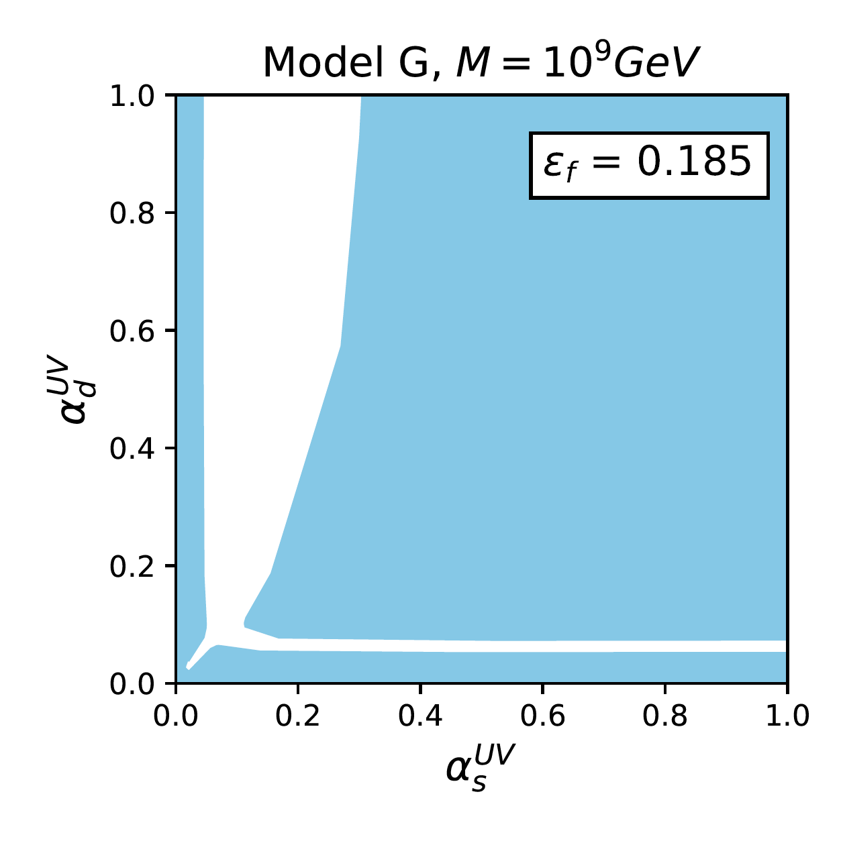
Explaining the coincidence problem
For a given model and choice of $M$, we can plot $Λ_{dQCD}$ on $(α_{s}^{UV}$, $α_{d}^{UV}$) axes
Goal:
we want models that naturally obtain $Λ_{dQCD}{\sim Λ}_{QCD}$
We choose a range of $Λ_{dQCD}$ values that would feasibly explain the coincidence problem :
$0.2GeV≤Λ_{dQCD}≤5GeV$
Define $ε_{f}$:
the proportion of the $(α_{s}^{UV}$, $α_{d}^{UV}$) parameter space that lies between the contours for $0.2GeV$ and $5GeV$
i.e. the proportion of parameter space that results in a feasible value of $Λ_{dQCD}$

Slide 16
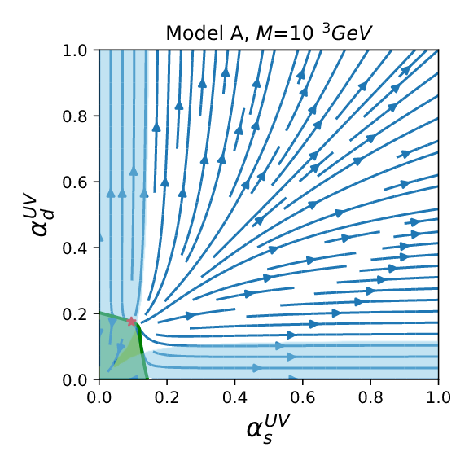
Asymptotic Freedom
Asymptotic freedom depends on $(α_{s}^{UV}$, $α_{d}^{UV}$)
Since $0<$ $α_{s}^{UV},α_{d}^{UV}<1$, our set-up is always perturbative below the Planck scale; however, some cases will be strongly coupled above that
Also define $ε_{f}^{AF}$:
the proportion of the asymptotically free $(α_{s}^{UV}$, $α_{d}^{UV}$) parameter space that produces feasible $Λ_{dQCD}$

Slide 17
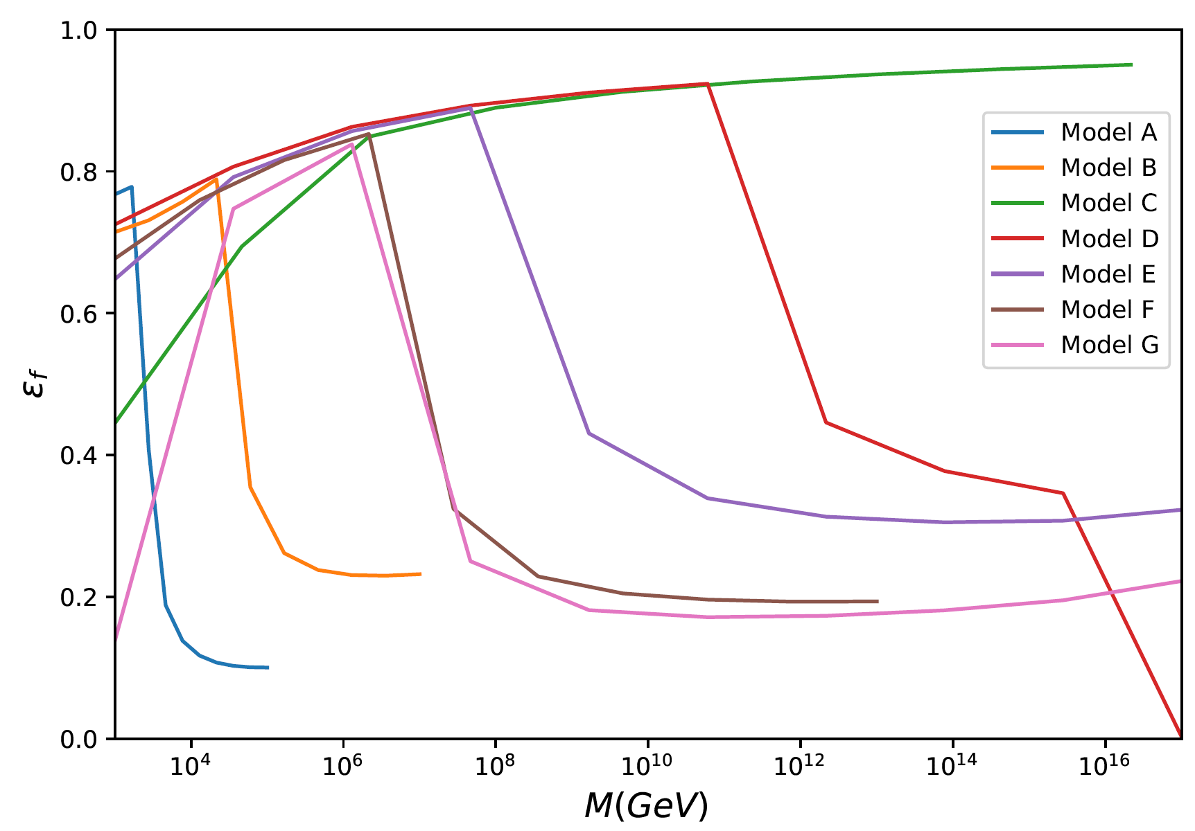
Explaining the coincidence problem
To quantify the feasibility of a model, we choose a minimum value for $ε_{f}\sim 0.7$
For a particular model, this defines ${\{M\}}_{f}$: the range of values for $M$ for which $ε_{f}>0.7$
Want to determine how robust the general theory is in explaining the coincidence problem.
Can ask a number of questions:
In the landscape of random field content selections, what is the distribution of ${\{M\}}_{f}$?
Do many models have a wide ${\{M\}}_{f}$?
Do many models have a narrow ${\{M\}}_{f}$?
Are there correlations between ${\{M\}}_{f}$and the field content of the model?

Slide 18
Concluding remarks
The cosmological coincidence is an interesting starting point for novel dark matter model building
Building models with similar particle masses for visible and dark matter is a non-trivial task
Infrared fixed points for dark QCD provide an interesting new direction for motivating the similarity of the visible and dark confinement scales
Thanks for listening!

Slide 19
Backup Slides

Slide 20
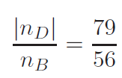
Dark QCD & IRFPs in an ADM model
This theory can be incorporated in an ADM model to provide a full model that explains the cosmological coincidence problem.
Bai and Schwaller described a simple thermal leptogenesis model to relate $n_{B}$and $n_{D}$, taking advantage of the new fields introduced for the IRFP mechanism
They introduced:
3 heavy right-handed Majorana neutrinos $N_{i}$
Two bitriplet fermions $Y_{1}\sim {(\overline{3},3)}_{1/3}$, $Y_{2}\sim {(\overline{3},3)}_{−2/3}$
One bitriplet scalar $Φ\sim {(\overline{3},3)}_{1/3}$
The mechanism:
Out-of-equilibrium decays of $N_{i}$ generate asymmetries in $Y_{1}$,$Φ$
These asymmetries are transferred into visible matter and dark fermions $X_{L}$
After equilibration and sphaleron reprocessing, the number density ratio is:

