Slide 1
A new stellar constraint on axion-like particles
Fred Hiskens
The University of Melbourne

Slide 2
Based on
M.J. Dolan, F.J. Hiskens and R.R. Volkas, Constraining axion-like particles using the white dwarf initial-final mass relation, JCAP 09 (2021) 010 [2102.00379]

Slide 3
Overview
Astrophysical ALP production & stellar cooling constraints
ALPs & asymptotic giant branch stars
Constraining ALPs using the white dwarf initial-final mass relation
Concluding remarks
A new stellar constraint on axion-like particles
1

Slide 4
Astrophysical ALP production & stellar cooling constraints

Slide 5
Axion-like particles
Axion-like particles (ALPs) are a class of pseudoscalar particle which appear frequently in extensions of the Standard Model (SM) of particle physics
A prominent dark matter candidate
Their masses and interactions with SM particles are model dependent
Studied in wide phenomenological range – particle physics, cosmology and astrophysics
Astrophysical ALP production & stellar cooling constraints
2

Slide 6
The energy-loss argument
It has long been realised that ALPs could be produced in deep stellar interiors
If sufficiently light and weakly interacting, they can freely escape the local stellar region
New source of energy-loss from stellar interior
Constraints derived in this manner are termed stellar cooling bounds
Burning region loses energy
Region contracts and heats
Nuclear burning intensifies
More efficient energy-loss
Accelerated evolutionary phase
Astrophysical ALP production & stellar cooling constraints
3

Slide 7
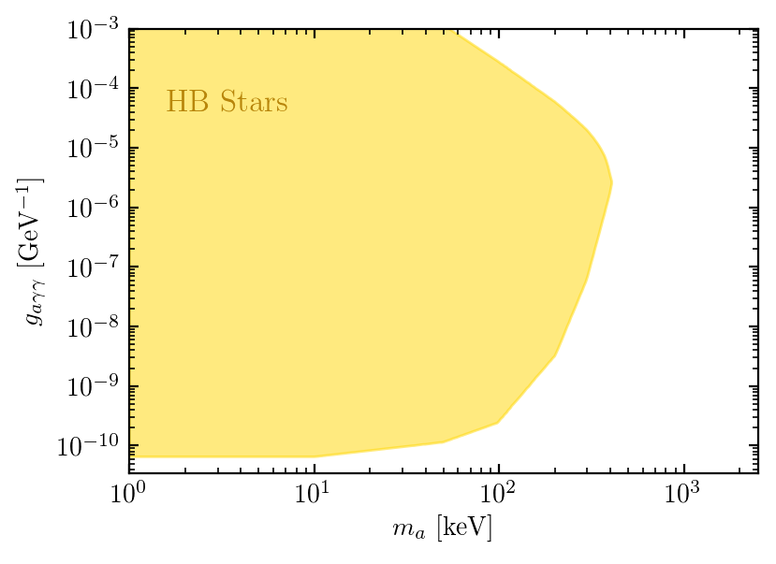
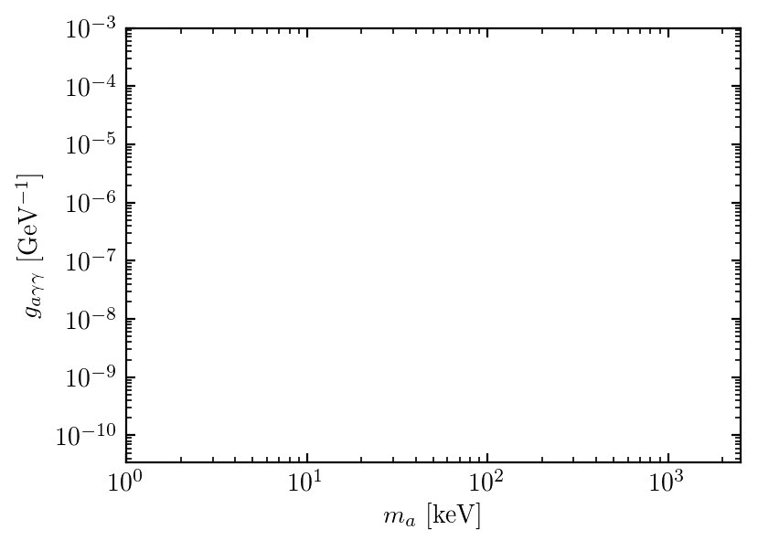
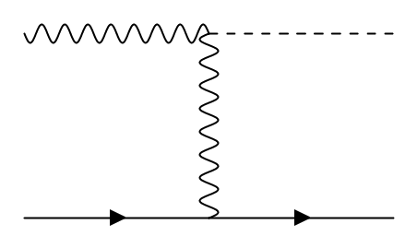
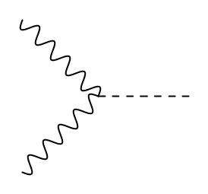
Exploring the parameter space
We are interested in ALPs which interact exclusively with electromagnetism via the two-photon vertex
$$ℒ_{γ}=−\frac{g_{aγγ}}{4}aF_{μν}{\tilde{F}}^{μν}$$
Most restrictive stellar cooling constraint comes from observation of horizontal branch stars
ALPs produced in He-B core through Primakoff mechanism and photon fusion
Both Boltzmann suppressed when $m_{a}≳T$ – cause HB constraint to relax in keV-MeV mass range
$$γ$$
$$a$$
$$γ$$
HB stars: arXiv 2004.08399
$$γ$$
$$a$$
$$e^{−}, N$$
$$e^{−}, N$$
$$γ$$
Primakoff production
Photon fusion
Astrophysical ALP production & stellar cooling constraints
4

Slide 8
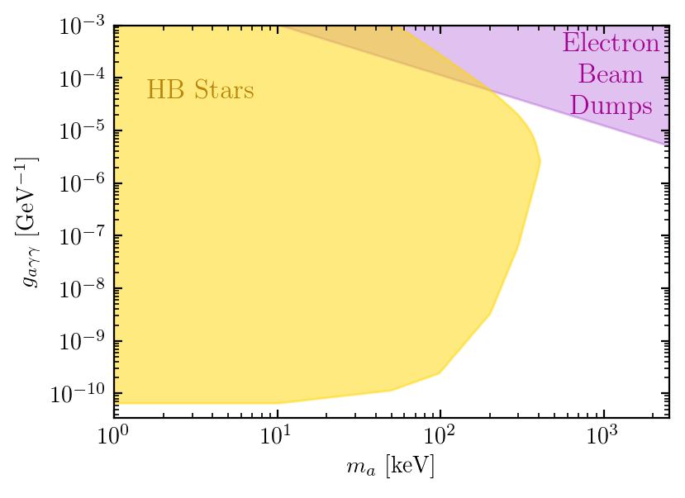
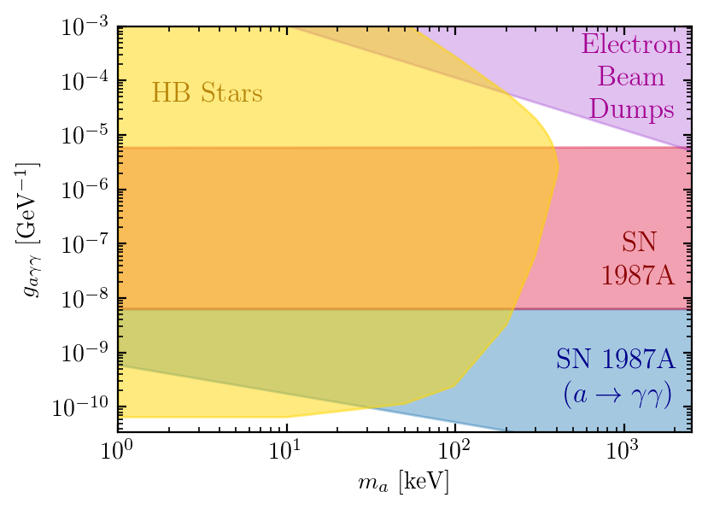
Exploring the parameter space
In keV-MeV mass there are other relevant constraints
Fail to exclude a small triangular region at $m_{a}\sim 1 MeV$ and $g_{aγγ}\sim {10}^{−5} GeV^{−1}$ - the cosmological triangle
Target subsequent (hotter) shell helium burning phase – the asymptotic giant branch
Investigate effects of ALPs using edited version of stellar evolution code Modules for Experiments in Stellar Astrophysics (MESA)
HB stars: arXiv 2004.08399
Beam dumps: Phys. Rev. D 38 (1988) 3375
SN1987A neutrino: arXiv 2008.04918
SN1987A visible: arXiv 1702.02964
Astrophysical ALP production & stellar cooling constraints
4

Slide 9
ALPs & asymptotic giant branch stars

Slide 10
The asymptotic giant branch
Evolutionary phase immediately following central helium burning in $0.6−8M_{⊙}$ stars
Separated into two phases
1. Early-AGB:
Evolution governed by activity of He-B shell
Shell progresses outward through helium layer
CO core & convective envelope grow
2. Thermal pulsating-AGB:
Strong stellar winds strip away star’s outer layers
Bridges the gap between E-AGB and white dwarf phases
Hydrogen envelope with convective region
Helium burning
Helium layer
Carbon-oxygen core
Hydrogen burning
http://www.astro.uvic.ca/~fherwig/DATA/index.html#ARAA%20article%20-%20The%20evolution%20of%20AGB%20stars
ALPs & asymptotic giant branch stars
5

Slide 11
The second dredge-up
In the late E-AGB the convective envelope can breach the helium-rich layer – the second dredge-up
Disperses nuclear fuel throughout outer layer – curtails CO core growth
Known that ALPs increase the efficiency of the second dredge-up [arXiv:9905033]
Investigate sensitivity of second dredge up / $M_{CO}$ to ALPs
Hydrogen envelope with convective region
Helium burning
Helium layer
Carbon-oxygen core
Hydrogen burning
http://www.astro.uvic.ca/~fherwig/DATA/index.html#ARAA%20article%20-%20The%20evolution%20of%20AGB%20stars
ALPs & asymptotic giant branch stars
6

Slide 12
ALPs & the second dredge-up
$M_{CO}$
w/o ALPs
$M_{CO}$
w ALPs
-1
$$M_{init}$$
$m_{a}$ [keV]
$g_{aγγ}$ [GeV ]
$$4M_{⊙}$$
10
$$0.66×{10}^{−10}$$
$0.80M_{⨀}$
$0.69M_{⨀}$
$$4M_{⊙}$$
300
$${10}^{−9}$$
$0.80M_{⨀}$
$0.75M_{⨀}$
$$6M_{⊙}$$
300
$${10}^{−9}$$
$0.96M_{⨀}$
$0.81M_{⨀}$
The second dredge-up is sensitive to ALPs in keV-MeV mass range – need a way to constrain this
The TP-AGB is short in intermediate mass stars – effects of ALPs persist through to final white dwarf mass
ALPs & asymptotic giant branch stars
7

Slide 13
Constraining ALPs using the white dwarf initial-final mass relation

Slide 14
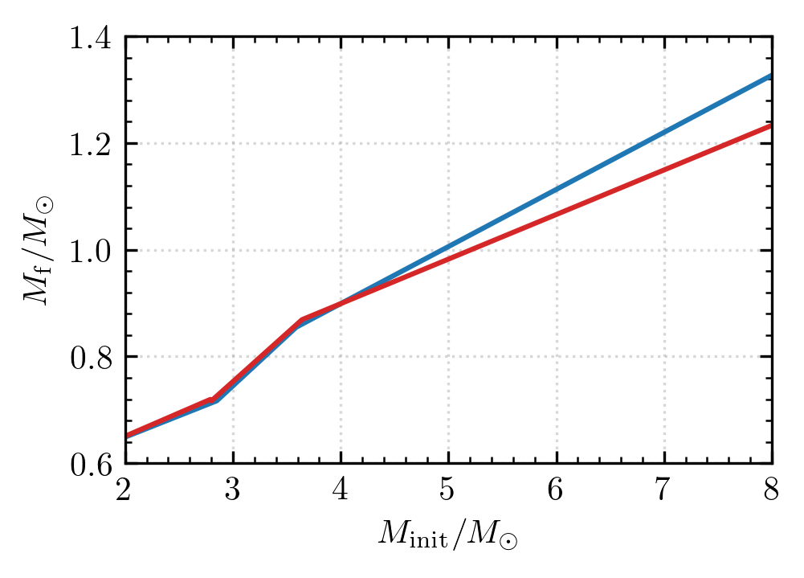
The initial-final mass relation
The initial-final mass relation: associates the mass with which a star forms on the Main Sequence to that of the white dwarf
Typically modelled as a three-piece linear function with breakpoints at $2$-$2.8M_{⊙}$ and $3.6$-$4M_{⊙}$
Numerous constraints on the IFMR exist - we use one derived from 14 wide double white dwarf binaries [1510.06107]
Minimises dependence on astrophysical uncertainties
Examples from [1809.01673]
Constraining ALPs using the white dwarf initial-final mass relation
8

Slide 15
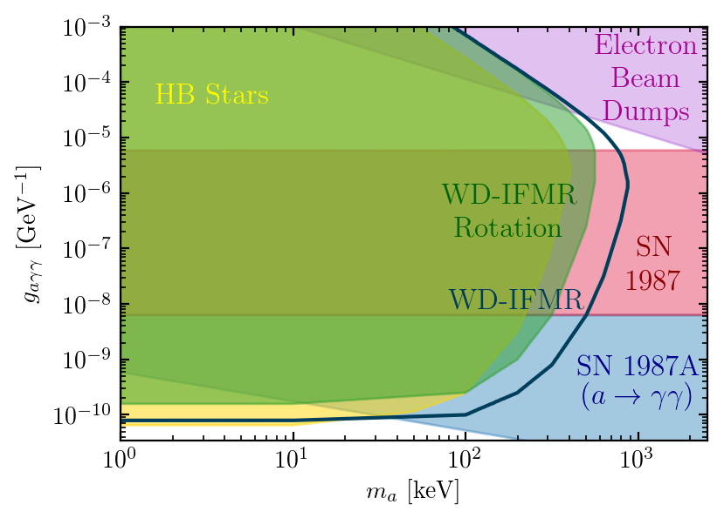
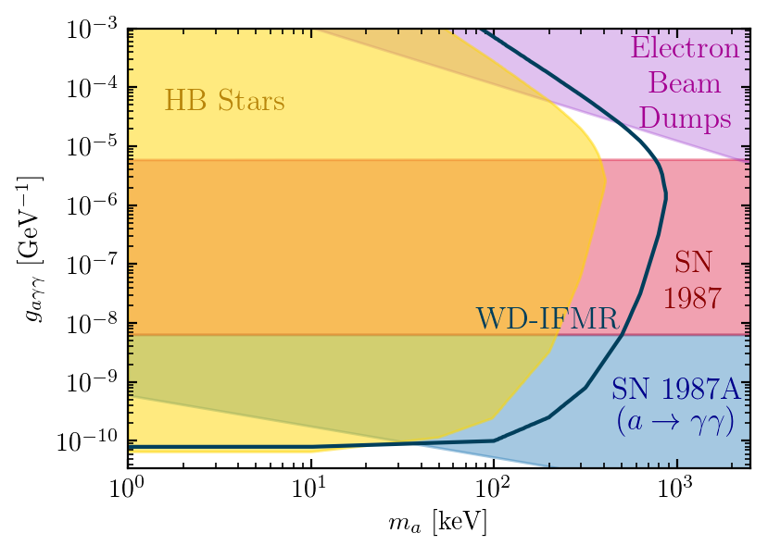
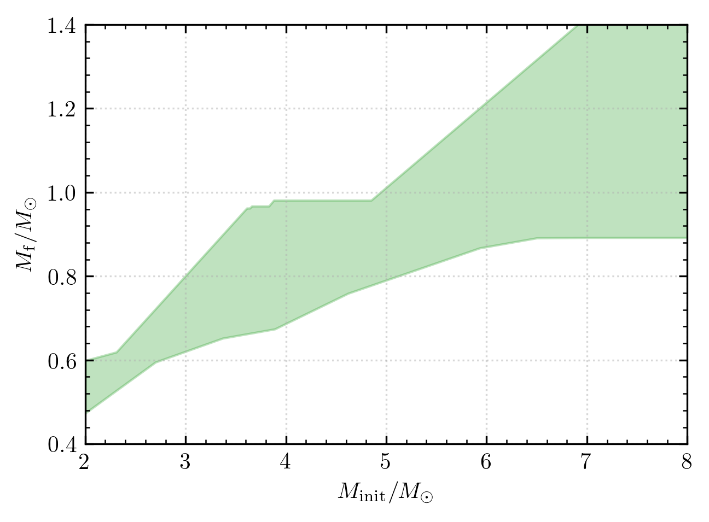
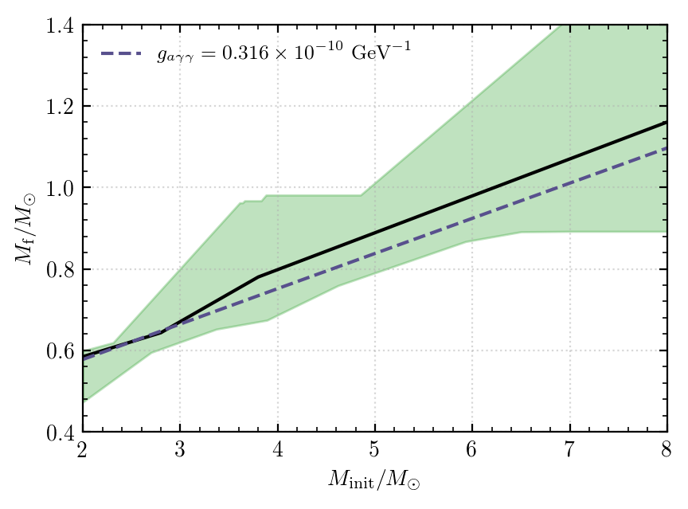
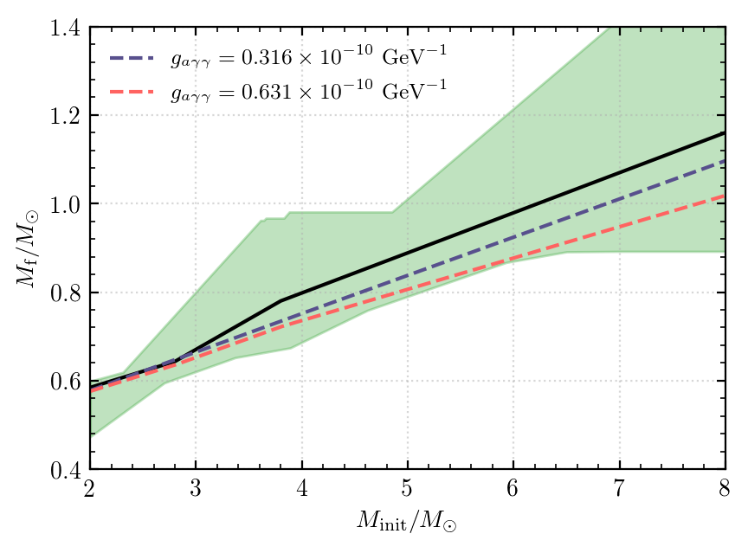
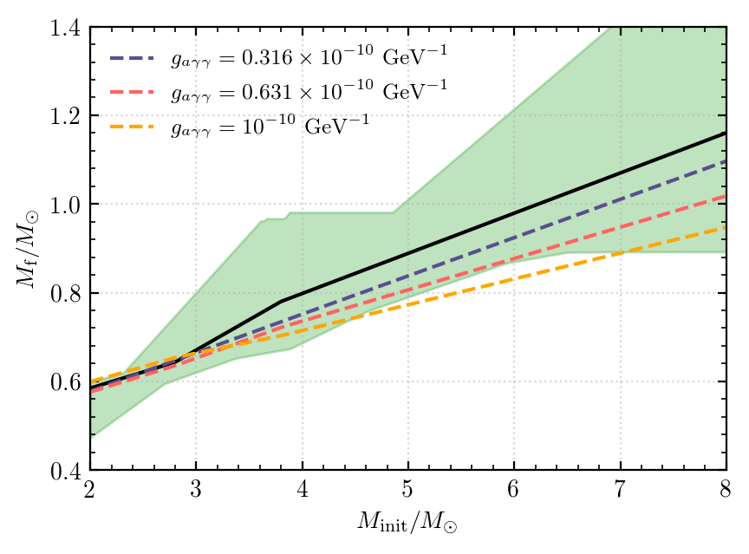
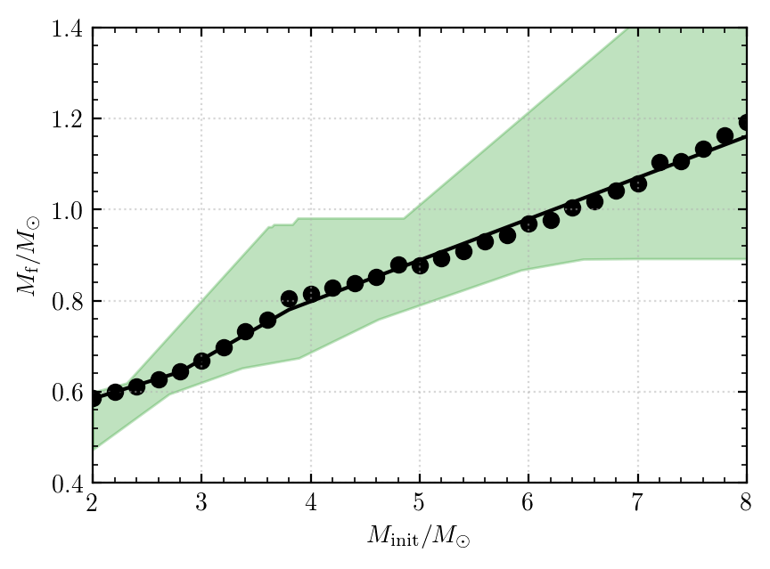
ALPs & the IFMR
Simulate evolution of stars with initial masses between $2$-$8M_{⊙}$ and record their final masses
Apply a three-piece fit with flexible breakpoints to derive a theoretical IFMR
Recompute with 10 keV ALPs included in the models for
$$g_{aγγ}=0.316×{10}^{−10} {GeV}^{−1}$$
$$g_{aγγ}=0.631×{10}^{−10} {GeV}^{−1}$$
$$g_{aγγ}={10}^{−10} {GeV}^{−1}$$
Define constraint by identifying smallest excluded value of $g_{aγγ}$ for fixed values of $m_{a}$
Relaxes when decay length falls below He-B shell radius
Conservatively account for systematic effects of stellar rotation by shifting our theoretical predictions upwards
Still able to exclude region of cosmological triangle
Constraining ALPs using the white dwarf initial-final mass relation
9

Slide 16
Concluding remarks

Slide 17
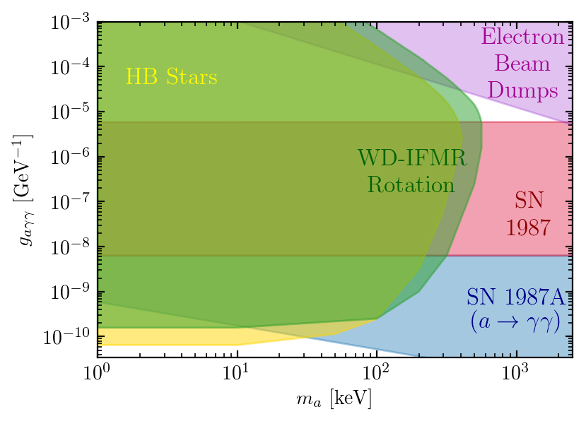
Concluding remarks
Stellar evolution simulations are a potent source of constraints on ALPs
Adopting a conservative approach we are still able to exclude part of the cosmological triangle using the IFMR
Applicable to ALPs with other couplings
Stands to improve significantly, e.g. 1400 white dwarf binaries in Gaia early data release 3
10

Slide 18
Backup Slides

Slide 19
Astrophysical ALP production
Restrict our attention to ALPs which couple solely to electromagnetism via the two photon interaction
$$ℒ_{γ}=−\frac{g_{aγγ}}{4}aF_{μν}{\tilde{F}}^{μν}$$
Have two production mechanisms of importance in stellar plasmas
Affects stellar structure by reducing the local energy production rate per unit mass $ε$
Magnitude of energy-loss given by
$$ε_{a}=\frac{g_{aγγ}^{2}T^{7}}{4πρ}\left(F_{P}\left(ξ,μ \right)+F_{F}\left(μ\right)\right)$$
$ε_{a}$ is Boltzmann suppressed when $m_{a}≫T$
$$γ$$
$$a$$
$$γ$$
$$e^{−}, N$$
$$e^{−}, N$$
Primakoff production
$$γ$$
$$a$$
Contain entire mass and composition dependence
Strong temperature dependence
$$γ$$
Photon fusion

Slide 20
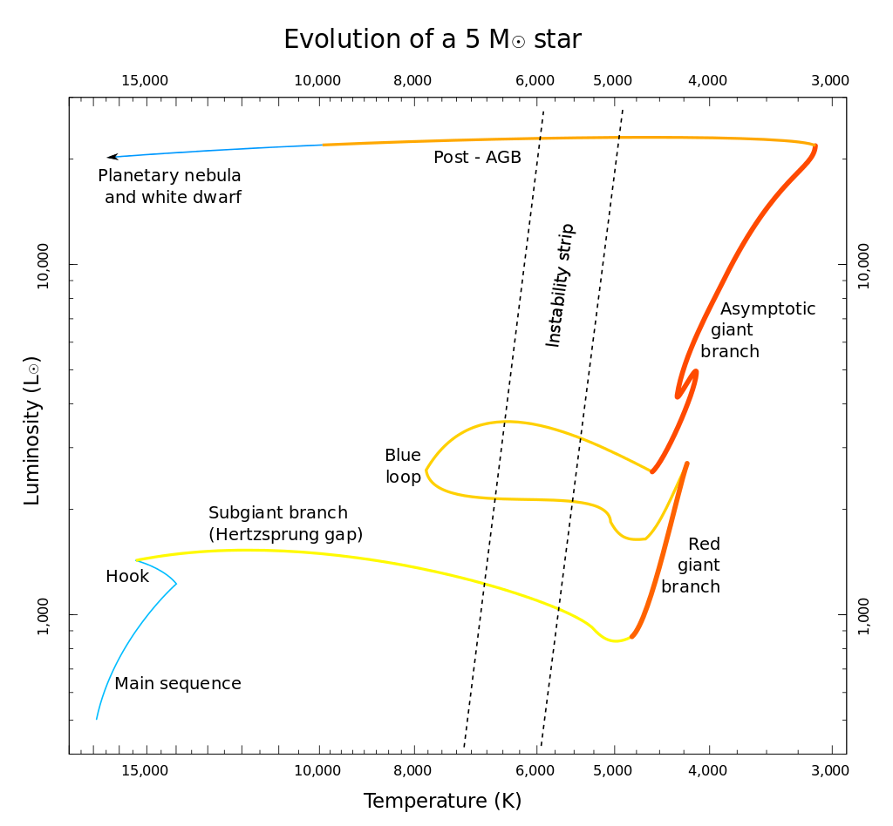
Evolution of intermediate mass stars
Consider the evolution of stars in the mass range $2$-$8M_{⊙}$
A star’s evolution is principally governed by its initial mass $M_{init}$ and metallicity $Z$
Described though observable parameters $L$ and $T_{eff}$ which define the Hertzprung-Russell diagram
Distinct phases in HR diagram arise due to different internal stellar structure:
Main sequence: H burning in core
Subgiant & red giant branches: rapidly contracting He core, H burning shell
Central helium burning: He burning core and H burning shell – blue loop
Asymptotic giant branch (AGB): double shell structure, inert CO core
Post-AGB and white dwarf: no further fusion, star cools

Slide 21
Towards a constraint
Demonstrated that the second dredge-up is sensitive to ALPs outside of the HB constraint
Need to find a way to constrain this behaviour
The AGB is a relatively short evolutionary phase in this mass range – sparsely populated
The TP-AGB is short in intermediate mass stars – little change to the core occurs
Can use observation of white dwarfs to constrain AGB astrophysics and the influence of ALPs!

Slide 22
Stellar rotation
Our 1D simulations do not account for stellar rotation
Enhanced mixing during Main Sequence increases core mass – shifts IFMR upwards
Average IFMR shifted upwards by between $0.04$-$0.08M_{⊙}$ [1901.02904]
Recompute constraint, shifting all theoretical IFMRs up by $0.08M_{⊙}$
Still able to rule out region of cosmological triangle

Slide 23
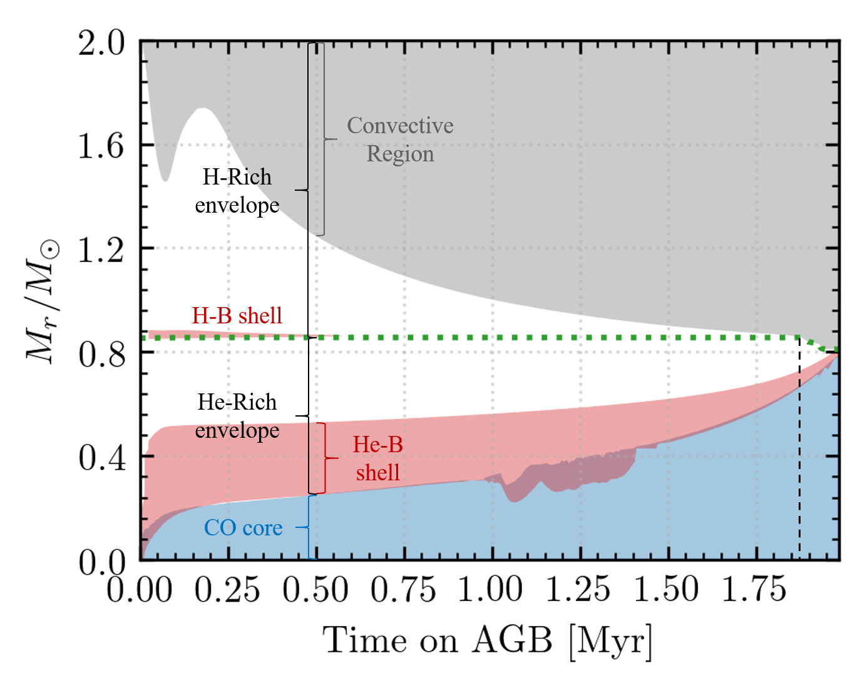
The AGB
The E-AGB:
E-AGB evolution predominantly governed by activity of He-B shell
Causes CO core growth, inhibition of H-B shell and further penetration of convective region
Terminates when He-B shell reaches H/He discontinuity
Ending hastened by the second dredge-up
The TP-AGB:
Long periods of stable hydrogen-shell burning interrupted by unstable helium-shell flashes
Lead to further CO core growth
Ends when strong stellar winds strip away the star’s outer layers
TP-AGB short in intermediate mass stars

Slide 24
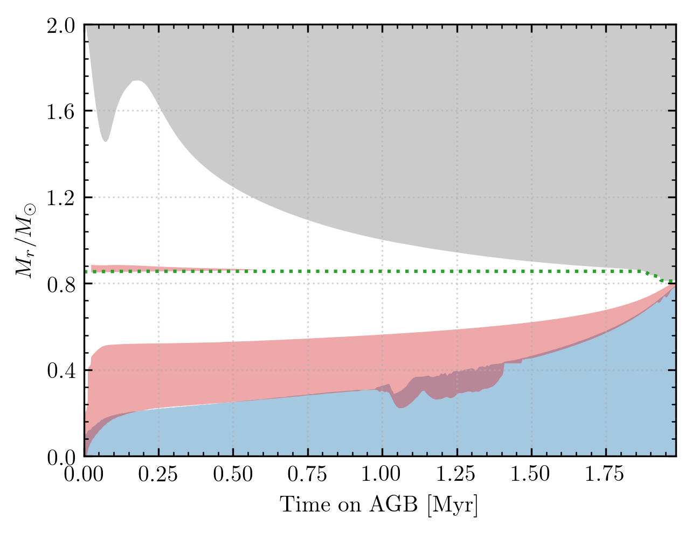
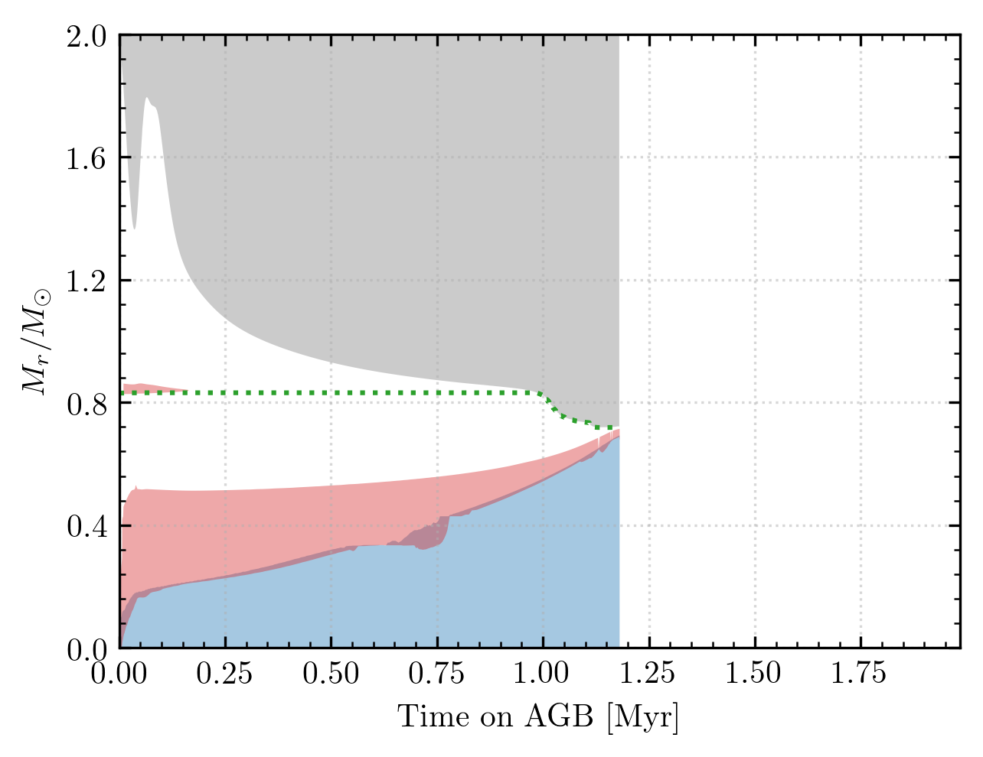
ALPs & the AGB I
First consider effect of ALP on the edge of HB star constraint
Duration of E-AGB shortened considerably
Second dredge-up occurs earlier and penetrates to greater depths
Both occur due to enhanced energy-loss within the He-B shell
Effects like this originally studied in 1999 [9905033]
$$0.8M_{⊙}$$
$$0.69M_{⊙}$$

Slide 25
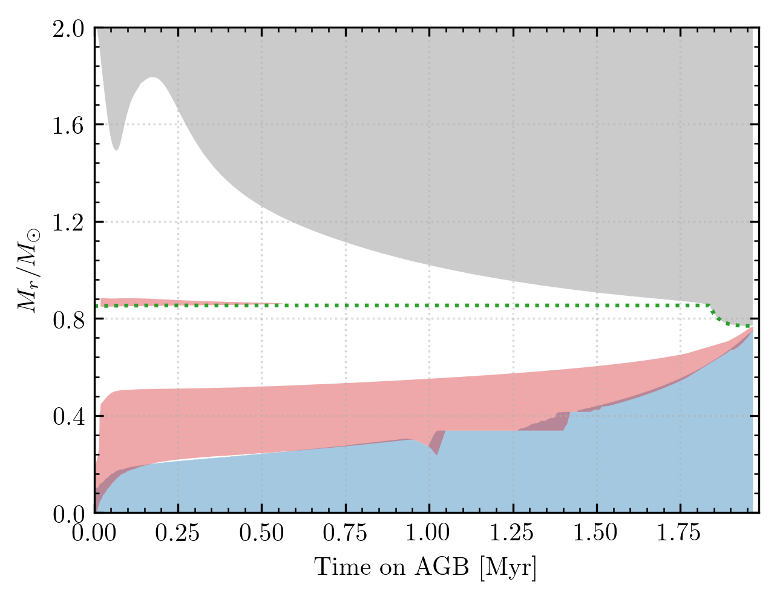
ALPs & the AGB II
Now consider heavier ALPs which are unconstrained by HB stars
Reduction in E-AGB duration no longer present
Models still predict a deeper dredge-up event
The second dredge-up is more sensitive to MeV scale ALPs than HB or E-AGB lifetimes
Predict larger reduction in more massive stars, e.g. reduction from $0.96M_{⨀}$ to $0.81M_{⨀}$
$$0.8M_{⊙}$$
$$0.69M_{⊙}$$
$$0.75M_{⊙}$$

Slide 26
Wide double white dwarf binaries
1
2
Spectroscopic analysis and WD cooling models
Three-piece linear IFMR
Stellar models
Compare
Observed properties
Guessed properties

Slide 27
Decay
$$λ_{a}=5.7×{10}^{−5}g_{aγγ}^{−2}m_{keV}^{−3}\frac{ω}{m_{a}}\sqrt{1−{\left(\frac{m_{a}}{ω}\right)}^{2}R_{⊙}}$$
$$ε_{a}^{P}=\frac{2}{ρ}\int{\frac{dp{ p}^{2}}{2π^{2}}Γ_{P}ωf\left(ω\right)}$$
$$ε_{a}^{P}=\frac{2}{ρ}\int{\frac{dp{ p}^{2}}{2π^{2}}Γ_{P}ωf\left(ω\right)e^{−λ_{a}/R_{region}}}$$

