Slide 1
SUPL - becoming operational
Dr Sue Barrell
Chair, SUPL Ltd

Slide 2
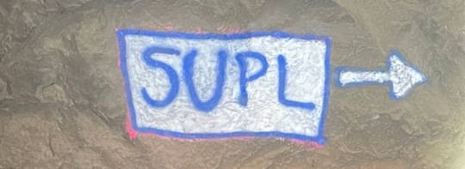
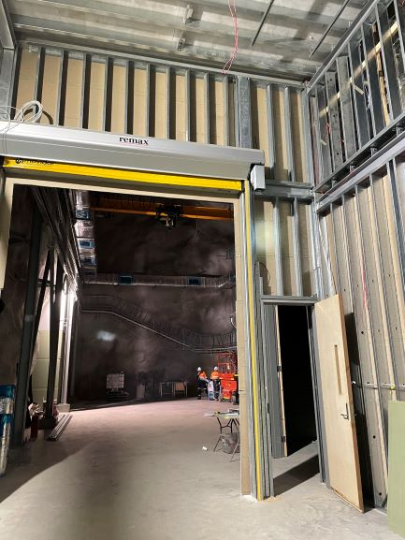
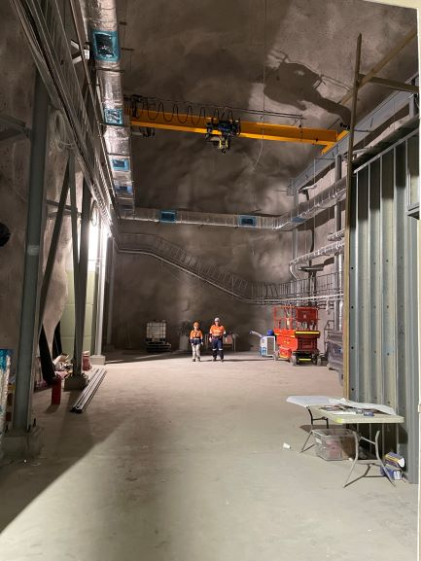
Status of SUPL construction
Major construction components and materials testing completed
Fit-out advanced and partially completed
Electrical sub-station installed (by SGM)
Electrical system redesign impacted target completion date (and cost)
Scheduled completion by late March/early April 2022

Slide 3
Status of SUPL Limited
SUPL Ltd exists officially as of 24 November 2021
Chair of SUPL Ltd Board – Sue Barrell
Directors – Liz Sonenberg (Uni Melb), Tim Senden (ANU), Alan Lau (Swinburne), Virginia Deegan (Uni Adel), Andrew Peele (ANSTO)
Thanks to all those whose efforts have got us to this point
SUPL Ltd will manage the operation of SUPL and the intersection with hosts, users & all relevant stakeholders
Focus now on completing construction, installation of experiments and finalising the plan, process & budget to ‘go live’

Slide 4
Key relationships
SUPL Ltd
Members & Board
National & International Partner Organisations
Funding bodies:
Victorian Government - RDV
Federal Government
Users:
Scientists and technical support
Innovators & future applications
Community bodies:
Northern Grampians Shire
Schools, community, outreach audience

Slide 5
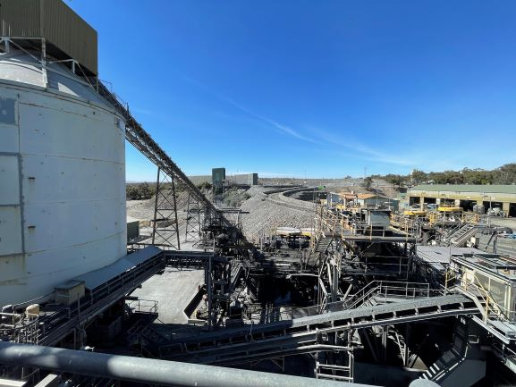
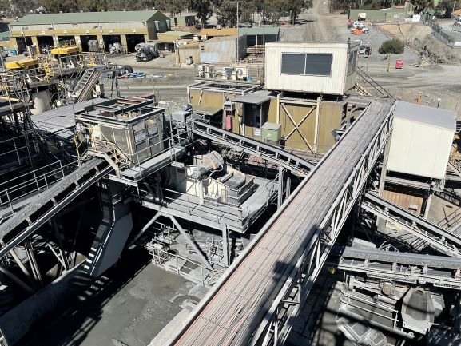
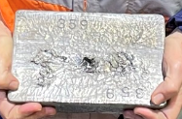
Stawell Gold Mine

Slide 6
Key priorities for SUPL Ltd
Maintaining and building relationships
Appointing SUPL Facility Manager & support
Understanding risk framework and safety environment
Understanding operational drivers, constraints & requirements
SGM operations – critical
SABRE & ANSTO
Operating plan for access, induction, safety, utilities, amenities
Above-ground support and working accommodation

Slide 7
Key messages for SUPL users
Respect for SGM people, safety procedures, access protocols and mining operations
Patience as we learn through install & commissioning phase
Balance user expectations vs ‘must haves’ vs ‘nice to haves’
Site access – volume, duration
Running cost of operations
Support for interpretive/outreach centre
Walk then run – explore potential for future experiments

