Slide 1
Media and Communications
Fleur Morrison
Annual Workshop 29 November 2021
Notes:
I’m Fleur Morrison and I’m the Communications and Media Officer at the Centre. I am a former journalist and have worked in media and communications with universities in Australia and the UK.
I’ve been with the Centre for just over a year now and I have to admit that when I started I knew very little about dark matter. Before my initial interview I Googled dark matter, so you can get an idea of the extent of my knowledge.

Slide 2

Communications priorities
Notes:
Since then, I’ve enjoyed getting to know about the work being done at the Centre and sharing and broadcasting its exciting and inspiring story with our members and the wider public. It is a privilege to have the opportunity to learn about your work and to spread the word about Australia’s role in this global search for dark matter.
As well as telling the story of the Centre, my other communications priority is to foster unity within the Centre, so that our members are not individuals working in isolation, but part of a cohesive and collaborative Centre that helps us get the best out of our research and foster the scientific talent of the future.
Within our Centre, our students and early career researchers are fortunate to have the opportunity to work with leading scientists from across Australia and the world. In this way we are an incubator for tomorrow’s scientific leaders and we can only do this effectively as a united and cohesive Centre that operates beyond university or state boundaries.

Slide 3





Snapshot of channels
Newsletter
Website
Media
Socials
Notes:
There are various internal and external channels I use to both share our story with the wider public and build unity within our Centre.
In this session I will provide you with an introduction to these channels, explain why we use them, and most importantly discuss how you can get involved.

Slide 4
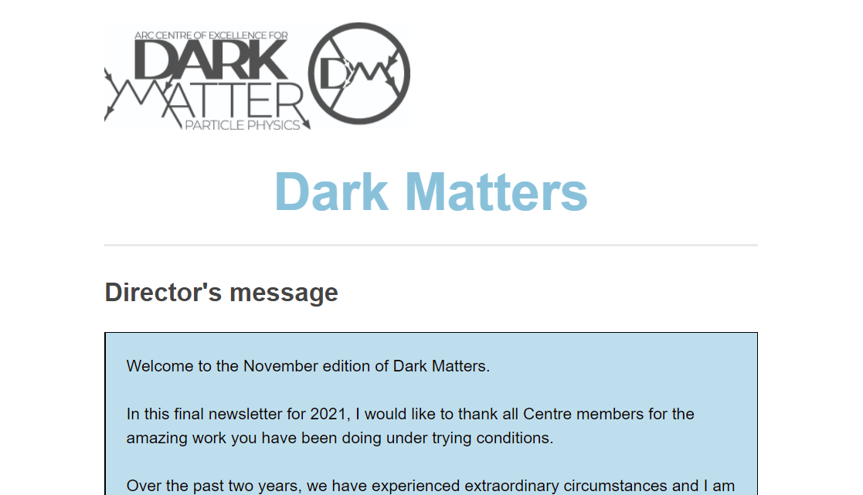
Newsletter
Inform
Celebrate success
Unite
Notes:
Our main internal communication channel is the Dark Matters newsletter, which is distributed every two months to all members of the Centre. It provides information on our news, events, successes and publications.
It also provides us with the opportunity to get to know each other by reading about and celebrating each other’s activities and achievements, especially in the absence of the opportunity to meet in person.

Slide 5
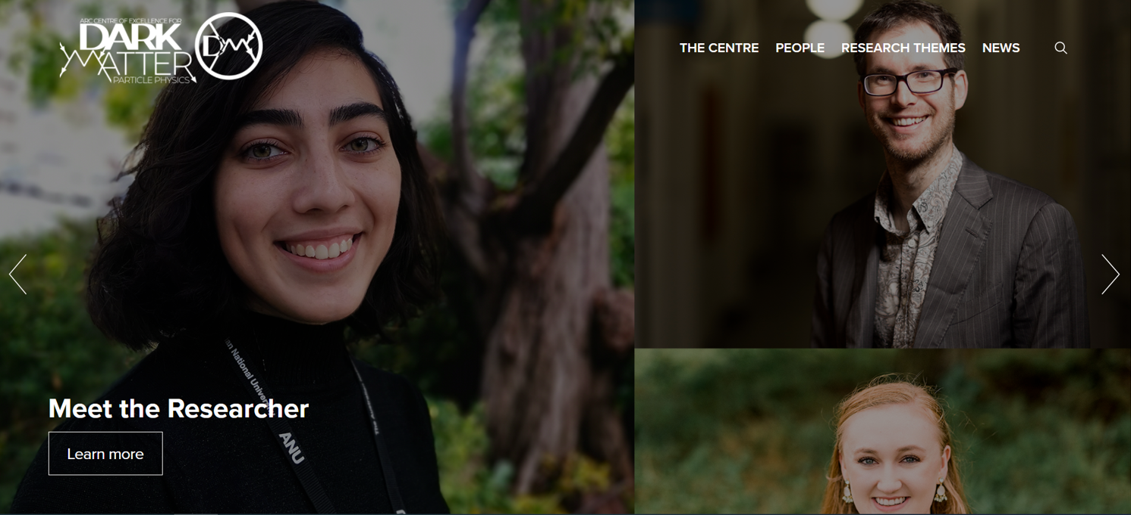
Website
www.centredarkmatter.org.au
Showcase
Celebrate
Inspire
Inform
Notes:
Our website is both an internal and external communication tool – it is the face of the Centre and the access point for a range of information for members and the public like events, jobs, centre news and research updates
Its aim is to provide information, promote our successes and our membership and foster an interest in science in the wider community. In particular, our Meet the Researcher series introduces the many, diverse faces and experiences of physics to new audiences.
It has been fascinating to talk to Centre members about their motivations for embarking on a career in physics as they are all completely different.
We hope that by highlighting this difference, that young people will see that they can pursue a career in physics, whatever their background. It is also a great way to introduce Centre members to each other, helping us become more familiar with each other’s background and experiences.

Slide 6
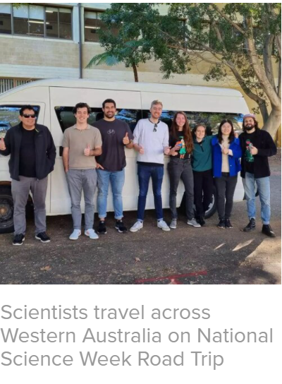
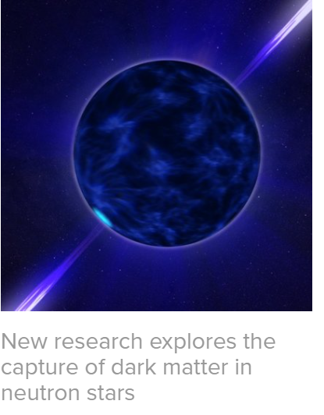
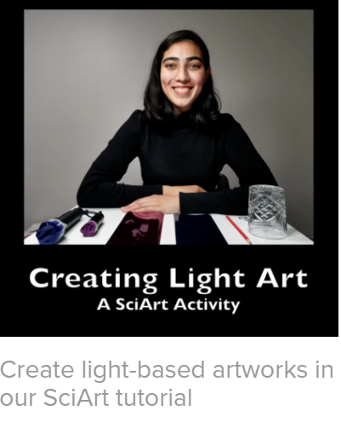
Notes:
I regularly update the Centre News section of the website and here are some examples of the events, initiatives and research that appear there.
In this section of the site, I aim to promote and celebrate our work and successes. These articles capture the activities from across the Centre, representing each node and a diverse range of members.
The website is a work in progress and there are updates on their way – the Themes sections will be fleshed out, a new portal will be available for Centre members and we aim to add educational content to the Outreach section of the site.

Slide 7
Media
Share excitement
Inspire
Promote
Notes:
The media plays a crucial role in enabling us to tell our story, introducing our researchers to a wide audience, engaging the public in our search for dark matter and inspiring future scientists.

Slide 8
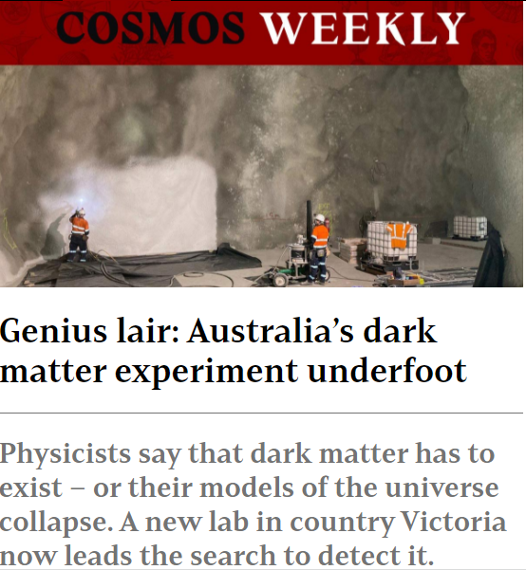
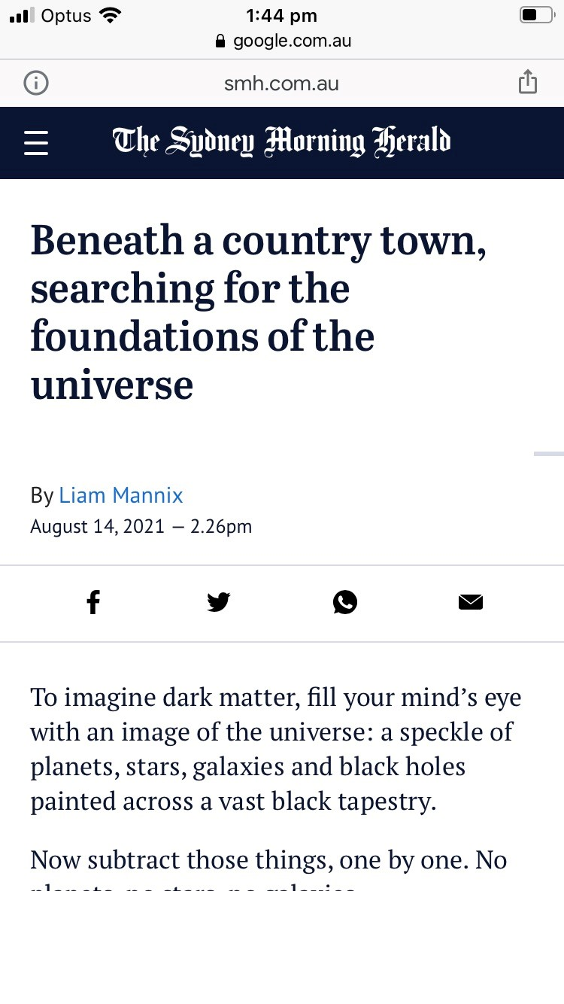
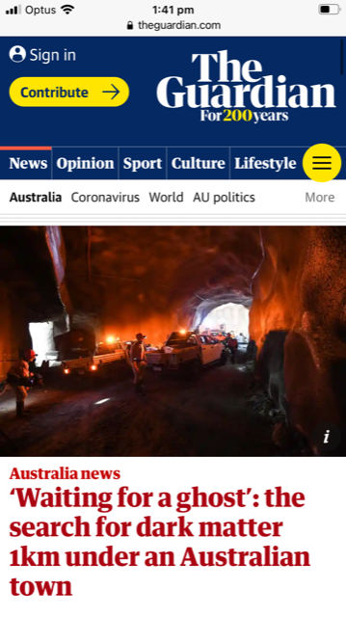
Notes:
In our Centre, we are fortunate to have a highly media-friendly story in SUPL.
SUPL is a wonderful way of showcasing the innovative and groundbreaking work happening in our Centre to national and international audiences, and providing a platform for the world-leading scientists who are doing it.
However, I am very aware that this is far from our only story and we need to work hard to ensure all our other stories are told alongside this one. It is crucial that we also spread the word about the fabulous research that is happening across the nodes, the talented and dedicated students and researchers involved and the events that we are holding at the Centre.
But, how do we attract attention to the more technical stories that might be hard for the lay person to understand? You might want to talk about a state-of-the-art piece of equipment or a new theory that is significant but hard to break down into easily accessible language.

Slide 9
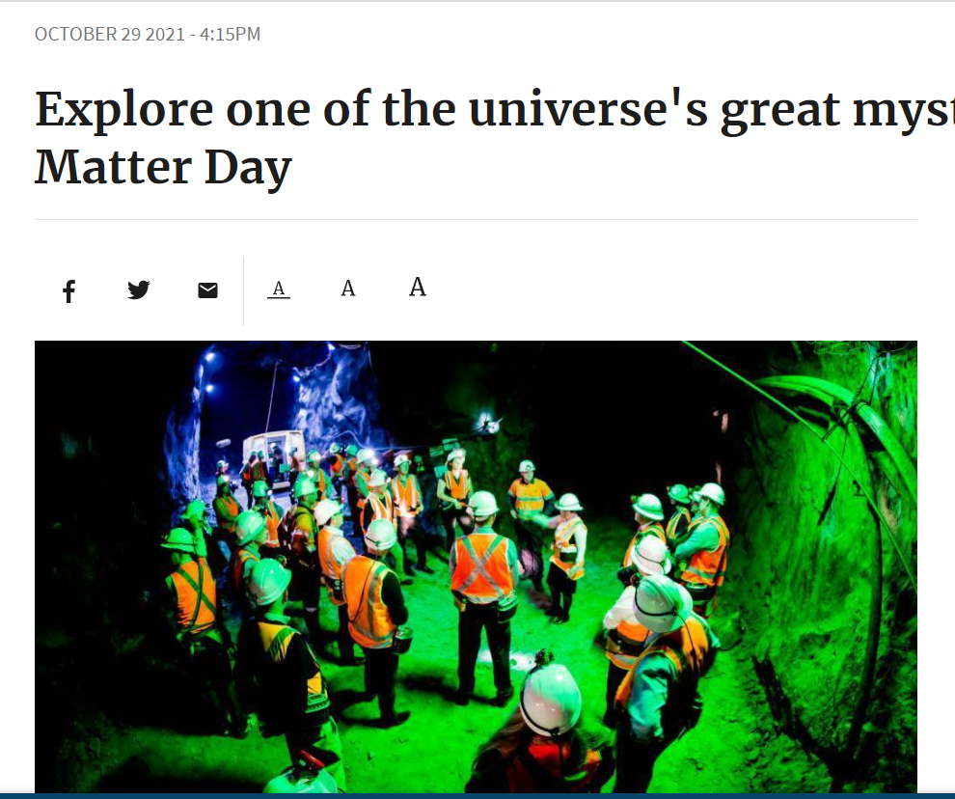
Notes:
Fortunately, in telling our story we can and do utilise SUPL’s pulling power as a springboard to promote the Centre’s wider work.
On Dark Matter Day, this meant Ben McAllister talking on ABC Perth about our Australia-wide search for dark matter, while also chatting about the underground laboratory and
Michael Baker explaining to Libbi Gorr on ABC Melbourne why we’re looking for dark matter underground, but also the broader picture of Australia’s role in the global search for dark matter.

Slide 10
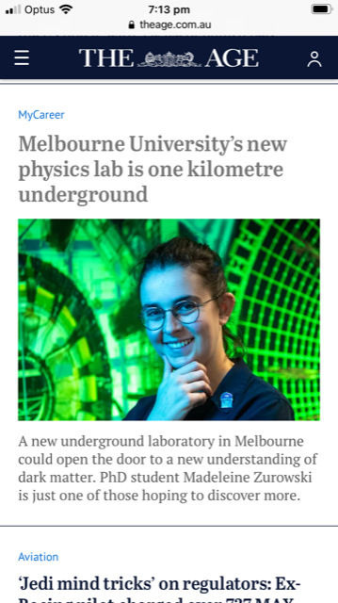
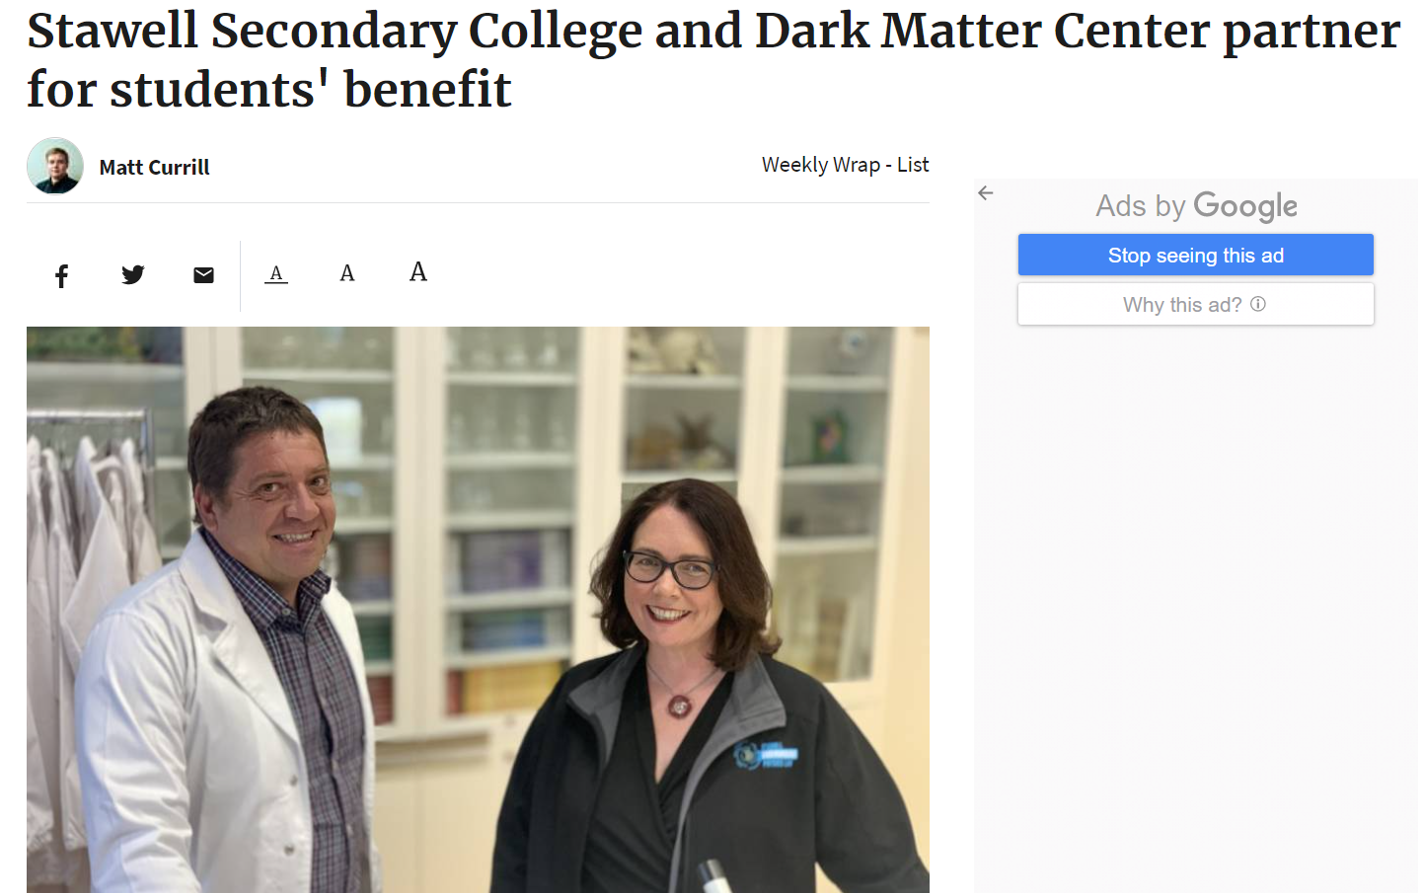
Notes:
We also drew on SUPL to promote our outreach program through our relationship with Stawell Secondary College and we promoted careers in science by publicising the confined spaces training our researchers have been engaging in to prepare for working underground.
This article drew a valuable picture of the excitement a career in science can offer, aligning with our Centre’s mission of inspiring the scientists of the future.

Slide 11
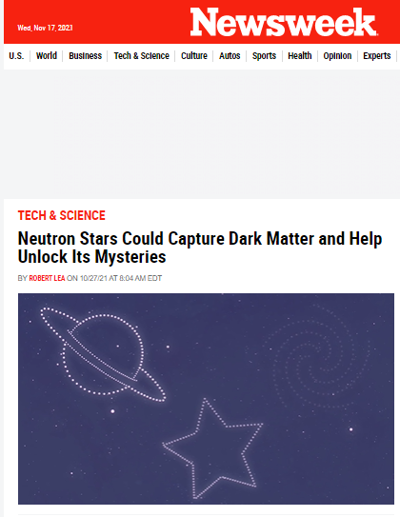
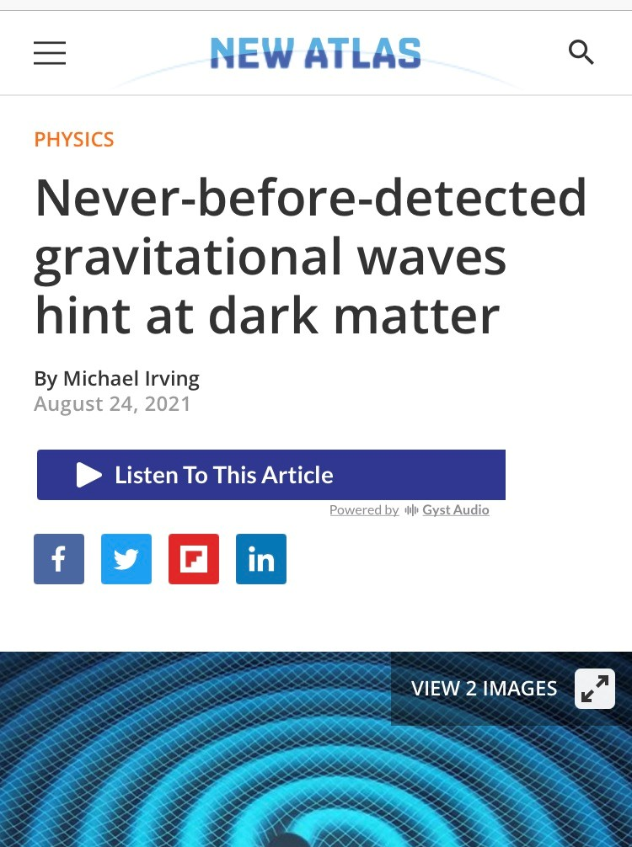
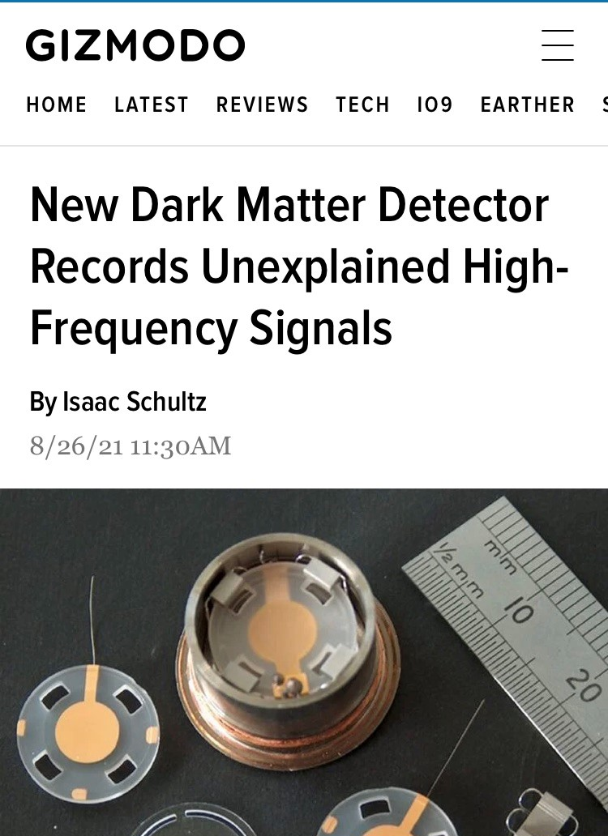
Notes:
The mainstream media is not always the best home for our stories, especially the more technical ones. Scientific publications can also be a fantastic way of informing the wider scientific community about our work.

Slide 12

Quirky
Local
Impact
Timely
Notes:
So, how do we ensure our stories attract the attention they deserve? Back when I was at university, I learnt that there are certain characteristics of a good news story: timeliness, quirkiness, location and impact. We can use these characteristics to ensure our own stories have the best chance of capturing the attention of the media.
We need to think about:
Is it timely? – has the research just been completed or the equipment recently been built?
Does it have a quirkiness factor? There’s a saying in the media that you no one is interested in the headline ‘Dog bites man’, but we are all going to read on if the headline is ‘Man bites dog’. This headline is surprising and makes us want to know more. Is there an element of the quirky or curious in your research?
Is it local? South Australian media and consumers of the news will be much more interested in research that was carried out in their own backyard so the local factor can help us target relevant media.
Finally, what is the impact of your research? What do the results mean for the reader and how will it impact their lives or contribute to their understanding of the world?
Every story does not need to contain each element, but thinking about them can help make our stories as attractive and newsworthy as possible.

Slide 13

Social media
Share excitement
Inspire
Promote
Notes:
Along with the traditional media, we are active on social media and throughout the year, our following, reach and engagement have all been growing.
In the past month our Twitter posts received about 4,200 impressions, which means our posts appeared on the feeds of 4,200 users. In the same period, our Facebook posts attracted over 49,200 impressions, due in part to two boosted posts along with organic content, and LinkedIn recorded 1,600 impressions.
To give you an idea of the posts that gain the most attention, the posts were about Dark Matter Day, the Centre launch, the Meet the Researcher series, an article about SUPL that appeared in The Guardian, and a MyCareer article in The Age.

Slide 14
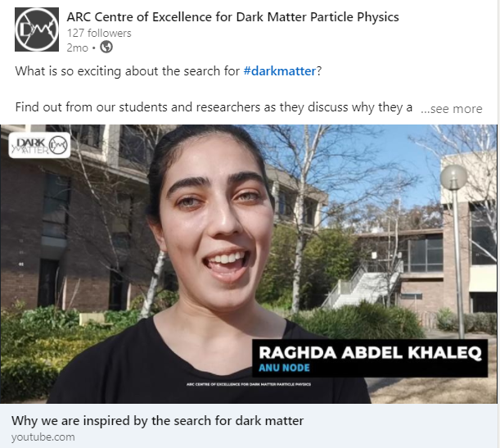
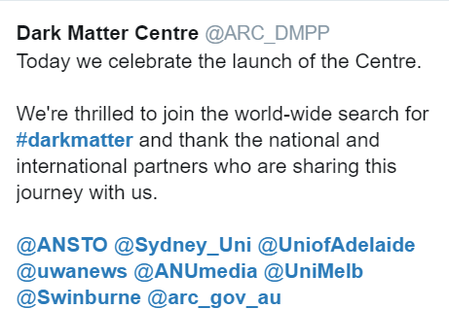
Notes:
Here are two of our most popular posts in the past year – celebrating our Centre launch and the release of our video for the event.
We are looking to consolidate our social media following in the coming year so please follow, engage with us and share our content.
You are also very welcome to send through your own content for any of our social media accounts.

Slide 15

Getting involved
Contact me
Write a brief
Media training
Introduce yourself
Seize opportunities!
Notes:
So, now that you know about the channels available to us and how we use them, what can you do if you have news or research you would like to share?
Let me know about it and we can discuss the best place for it, whether in the mainstream media, a scientific publication, our newsletter, social media or on our website. If you have research you would like to spread the word about, I can send you some instructions on writing a research brief to help you summarise and explain to me, and to a wider audience, what your research means.
I know that some of you have put your names down to be involved in media training and I have passed your details on to your university’s central media team. However, with restrictions and restructures at many universities this year, it has been a bit of a struggle getting this underway. In 2022, I hope to arrange media training within the Centre for those who are interested.
You might also like to introduce yourself to your university media team so they are aware that you are available to be interviewed about your work, and I can put your names forward for events like National Science Week.
And just a final piece of advice on engaging with the media – timeliness is everything and when a journalist asks to interview an academic, we only usually have a couple of hours to respond. So please, if I get in touch about a media request, let me know as soon as you can whether you would like to be involved.

Slide 16

fleur.morrison@unimelb.edu.au
Notes:
Finally, thank you to everyone who has been helping to promote the Centre’s work – whether by being interviewed, contributing content or keeping me informed. It would be futile for me to try to do this job in isolation and I rely on you to let me know what is happening in your node.
I want to hear your news, research, and ideas. Nothing is too small – if there is something you would like to share, we can always find a home for your story.
I’m looking forward to another year of sharing the story of the incredible and inspiring work being done across the Centre.
Together, we can engage those who, like me, had no idea of the significance and excitement of Australia’s search for dark matter, and inspire young Australians to pursue a career in which they have the opportunity to explore the universe’s big questions.
We can also help build a cohesive, collaborative and supportive Centre that benefits us all, and with an impact that spans far beyond our own membership.

